Slide 1
How did the Allies turn the tide of WWII in
Europe and Africa???
4/13

Slide 2
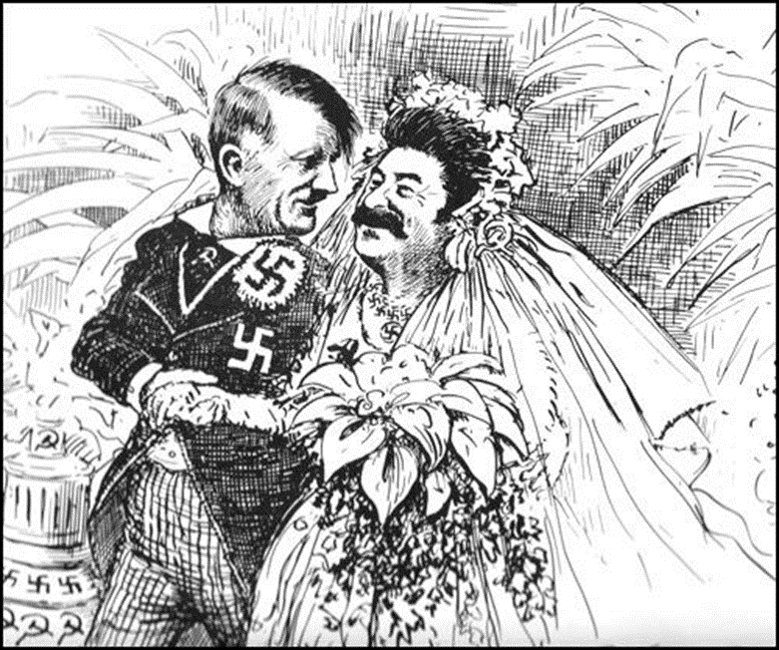
Do Now: 4/13
Review……What was the Nazi-Soviet Pact???

Slide 3
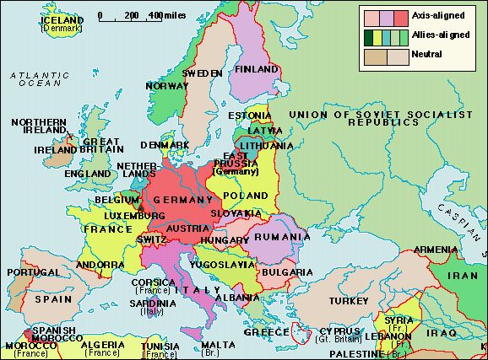
WWII in Europe and Africa
War Begins Sept. 1939 when Hitler invades Poland using Blitzkreig
Nazi-Soviet Pact: Germany and Soviet Union agree to divide Poland and not attack each other.
Stalin (S.U.) takes advantage of this pact to gain land annexing:
Estonia, Lithuania, Latvia, & Finland

Slide 4
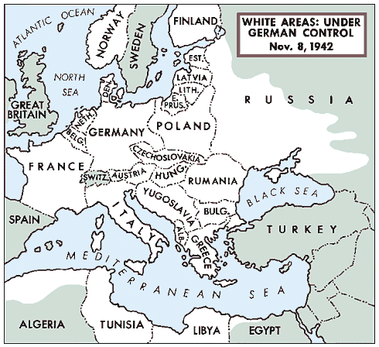
War in North Africa
Axis Powers want Egypt which would give them control of the Suez Canal.
This canal was the key to Oil Fields of the Middle east
Germany sends General Erwin Rommel “The Desert Fox” to command the new German Tank Corps in Africa
Axis Powers were close to taking control of Egypt.

Slide 5
Axis Control -June 1941
1941-1942 Dad Days for the Allies
Most of Europe was in German hands.
Hitler now looks to the Soviet Union Video Link click

Slide 6
Hitler Invades the Soviet Union
June 22, 1941 Hitler breaks the Nazi-Soviet Pact and invades the Soviet Union
Known as Operation Barbarossa
Soviet Red Army – 5 million men strong but poorly equipped compared to Germany
Germany pushes 700 miles into the Soviet Union and the Soviet Army burns and destroys everything left in Germany’s path.
Although millions of soviets die they refuse to Surrender

Slide 7
Operation Barbarossa Continued…
Hitler’s main goal is to capture Moscow the Soviet Capital
Eventually the harsh soviet winter sets in and forces Germany to retreat. Oil in their Tanks, trucks and weapons all froze and became useless
Moscow was saved
500,000 Germans were dead because of the weather, not the war.

Slide 8
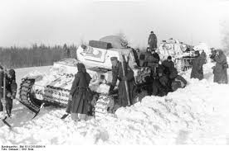
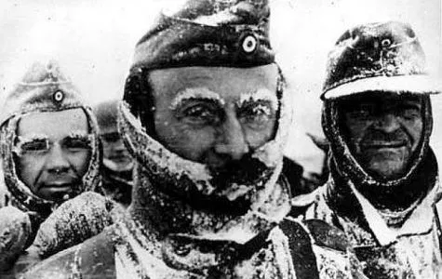
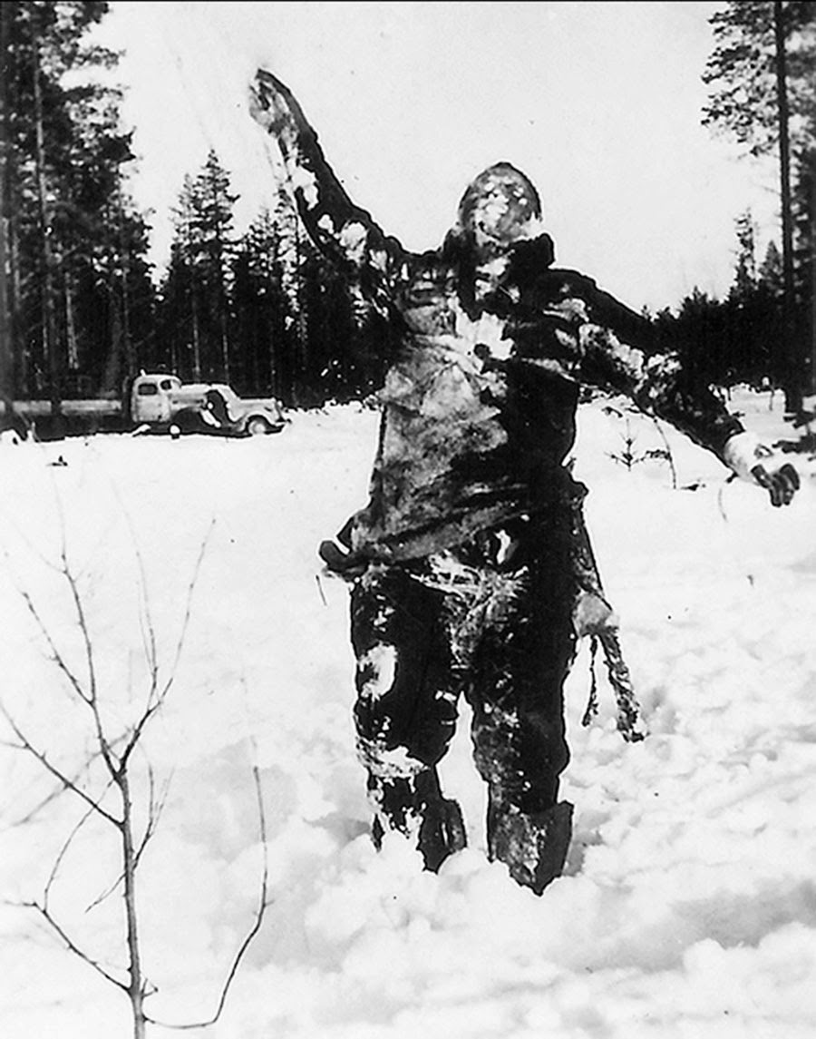
Why You Don’t Invade The Soviet Union in the Winter
https://www.youtube.com/watch?v=xyvkKuux04w&list=PLAECOVH4ypxytrybezo8MnFMLRQQGTp1Y&index=2&t=0s

Slide 9
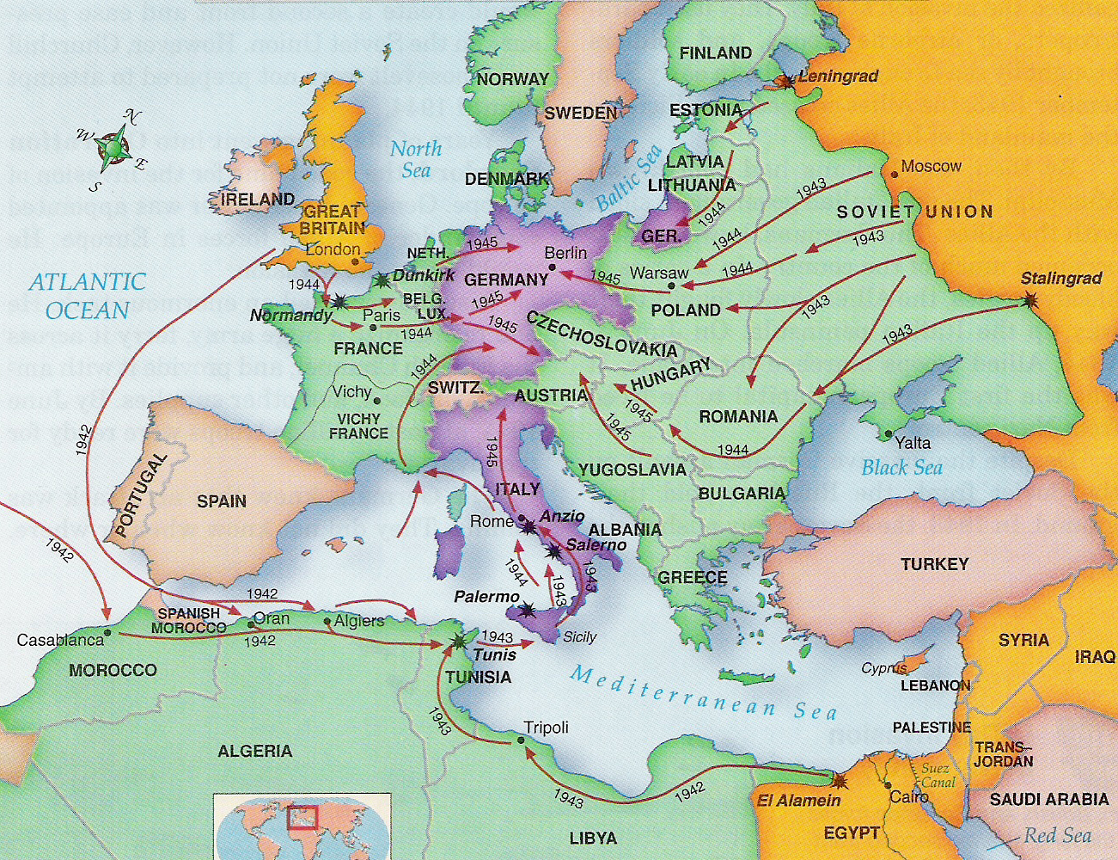
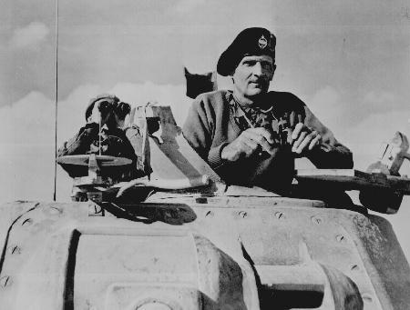
Turning Points: EUROPE
Success in North Africa
Allied victories against Germany at El Alamein & Tunisia provided bases for an advance on Italy
British Gen. Montgomery at the Battle of El Alamein

Slide 10
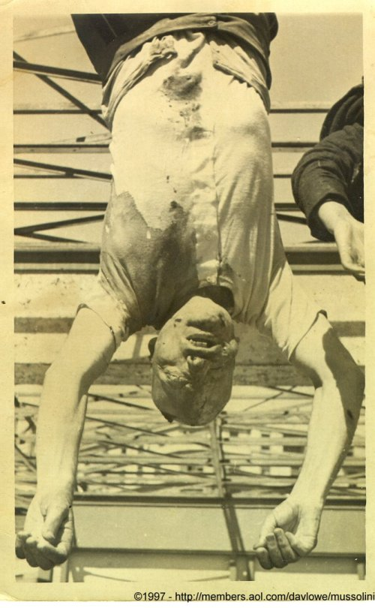
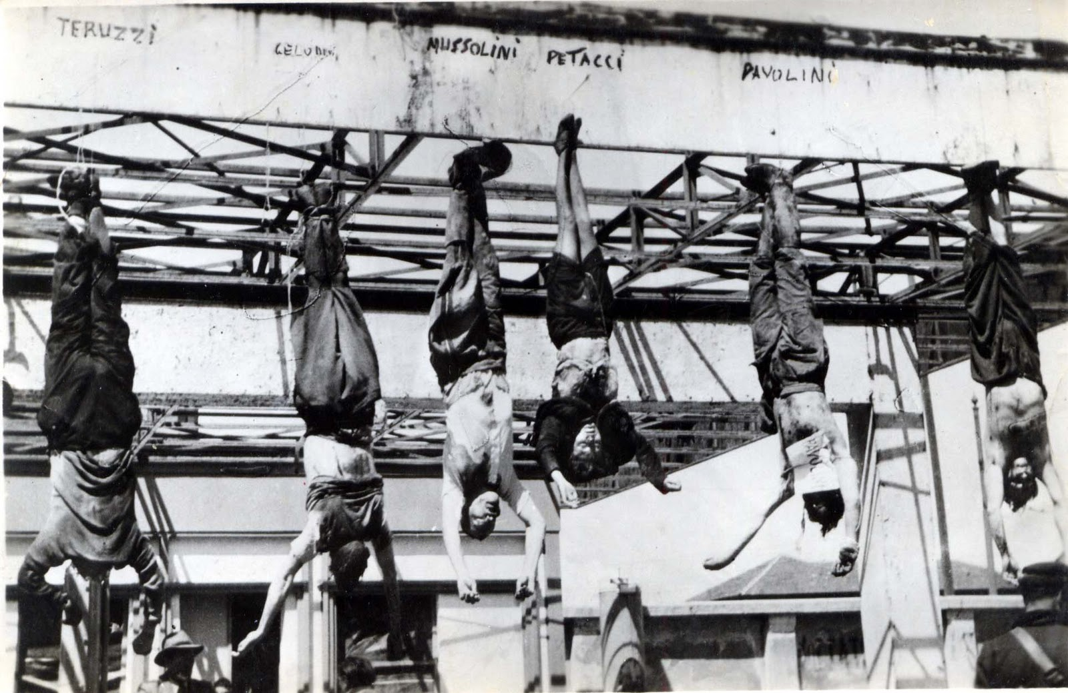
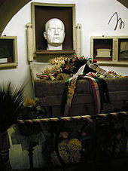
Turning Points: EUROPE
Invasion of Italy-1943
From bases in N. Africa, the Allies invaded the Island of Sicily & than the Italian mainland.
The Italians had already overthrown Mussolini
In a series of bloody battles, the Allies liberated Italy from the Nazis

Slide 11
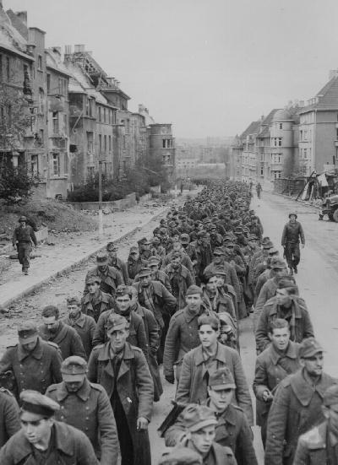
Turning Points: EUROPE
German Troops Surrender
German Surrenders in the USSR-1943
The German Army was slowly pushed back to Eastern Europe by Soviet Forces at Stalingrad & Leningrad

Slide 12
https://youtu.be/3jMEE21Gxas
The Allied Invasion of Italy.
Tomorrow 4/14 & 4/15 D-Day

