Slide 1
The Cold War
An introduction as to what a “Cold War” is, and how it was fought.

Slide 2
From Allies to Enemies
Just after the end of WWII the U.S. and the Soviet; both Allies during WWII, begin to engage in a new kind of a war against each other. This “Cold War” will last for nearly 50 years?
AIM: What is a “cold war”, as opposed to a “hot war?” Why did this war stay “Cold?”
The Soviet Union and the U.S. didn't directly fight against each other in the Cold War, even though they were dangerously close to doing so. If they did, then it would have been a "hot" war. But there were various other ways in which they actively fought!
For example….

Slide 3
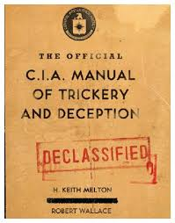
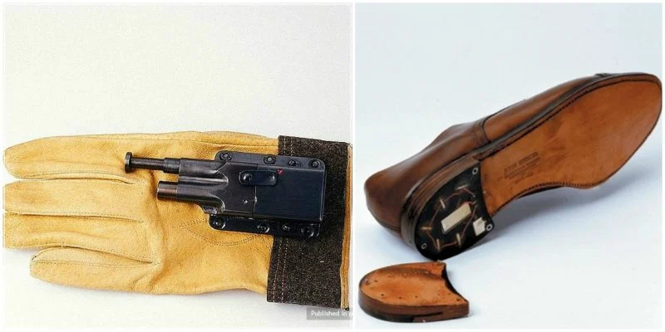
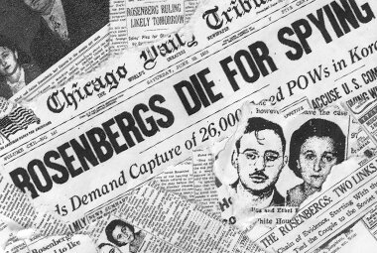
1) Intelligence
Both sides were actively spying on each other in an attempt to gather as much military secrets and other top-secret information as possible about the enemy. Each side had their own national intelligence agencies which were responsible in carrying out these tasks. For example – The US created the CIA and the Soviet Union had the KGB.

Slide 4
Media Propaganda (spreading rumors)
During the Cold War, each side tried to portray each other's government and social living order as inferior, "evil" and a great injustice to mankind, through the use of newspapers, books, television, radio etc.
American Propaganda
The Americans tried to portray the Soviets and other communists as having a cruel and dictatorial regime which ignored human rights.
Anti-communist sentiment influenced nearly all areas of life.
Many Hollywood films and some cartoons, showing the Russians, as the bad guys, eventually being defeated.
Soviet Propaganda
The Soviets also used propaganda as a tool to portray the Americans and other Western capitalists as fat, greedy, money-worshiping businessmen who treated their workers as slaves.
In schools, pupils were taught to be anti-American, and history was regularly rewritten to fit the official government view. Also, radio stations, such as Radio Moscow, and television channels showing propaganda, were funded. Many films were released portraying the West as imperialistic and expansionist. One U.S. film called "Uncle Tom's Cabin", about a black slave in America, was used and highly publicized by the Soviet Union, so to depict the West as "evil" and racist.

Slide 5
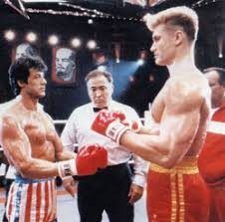
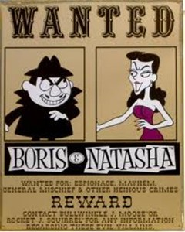
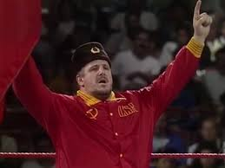
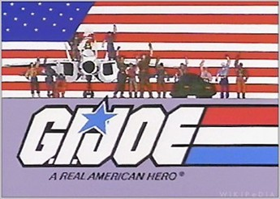
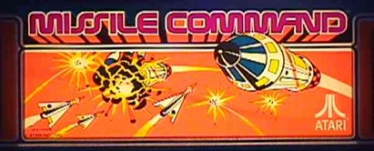

Slide 6
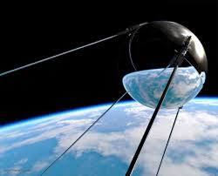
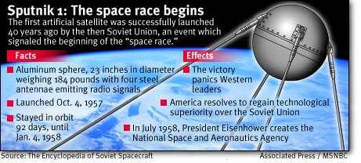
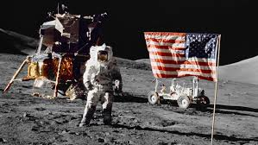
The Space Race
The technological race between the USA and the Soviet Union wasn't just on Earth. It also reached into space in what came to be known as the "Space Race". Both sides competed against each other to explore inner space. The USSR started the Race by sending the first ever satellite, "Sputnik" into orbit. For the next half a century, they competed to be the first country to put a man in space or on the moon and to explore the planets.

Slide 7
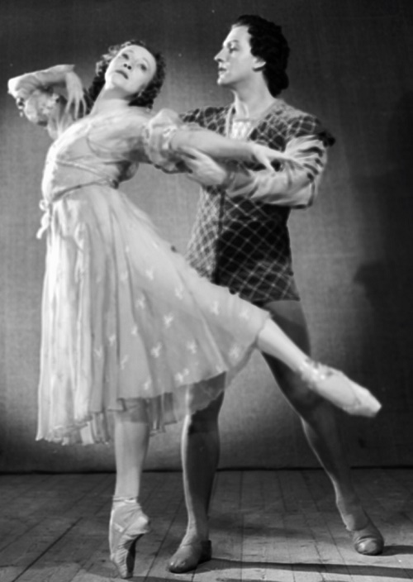
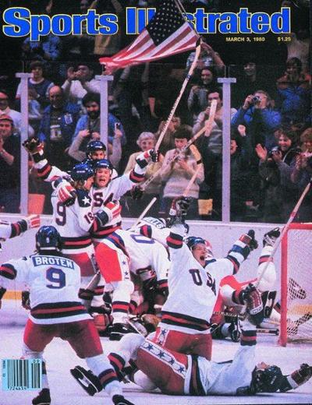
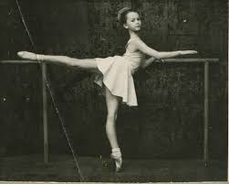
The Prestige Race
The US, and the Soviet Union invested time and money into developing arts, culture and sports that made their country look superior. The Soviet Union was well known for their artistic contributions in Ballet and Chess, in response New York City began funding new Ballet troupes to compete. But where both nations sank the most money was into their sports programs. Soviet Athletes were well paid and trained from an early age to win Olympic gold. The U.S. began the practice of giving college scholarships during the Cold War to encourage American athletes to excel in their sport and to defeat the Soviet Union in the Olympics.

Slide 8
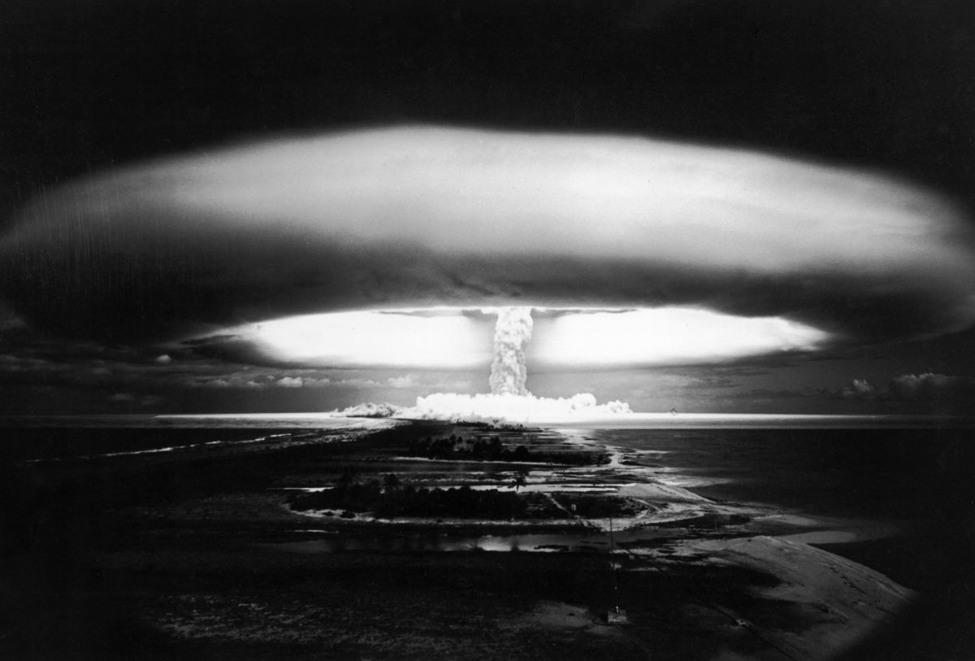
The Arms Race
Although Soviet and American forces never directly fought each other, they both engaged in a race to develop the most powerful weapons they could. Both sides believed in a policy of "mutually assured destruction," which meant that if they ever did attack each other, the resulting war would be so horrible that neither side would be left standing. Nuclear weapons were a key part of this, and both sides continually worked to create more powerful bombs and more efficient delivery methods for them. This had a powerful impact on average citizens, many of whom installed bomb shelters and took other precautions out of fear of a nuclear attack.

Slide 9
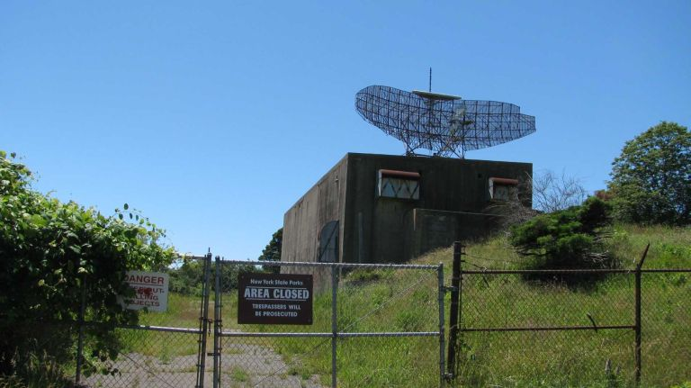
A Defense Race
Both the US and the Soviet Union develop, more advanced forms of Radar to monitor the air space around their nation, and to potentially shoot down incoming nuclear Nuclear missiles. At the minimum provide enough warning. The US installs radar screens up and down its coasts, and develops radar planes. Plans are in the making to install lasers on the moon that could potentially shoot down Soviet Missiles.

Slide 10
In your notebook answer the following Question/aim of the day:
What is a “cold war”, as opposed to a “hot war?” Why did this war stay “Cold?”

