Slide 1
Part 2 - Notes
How did the Allies turn the tide of War in Europe

Slide 2
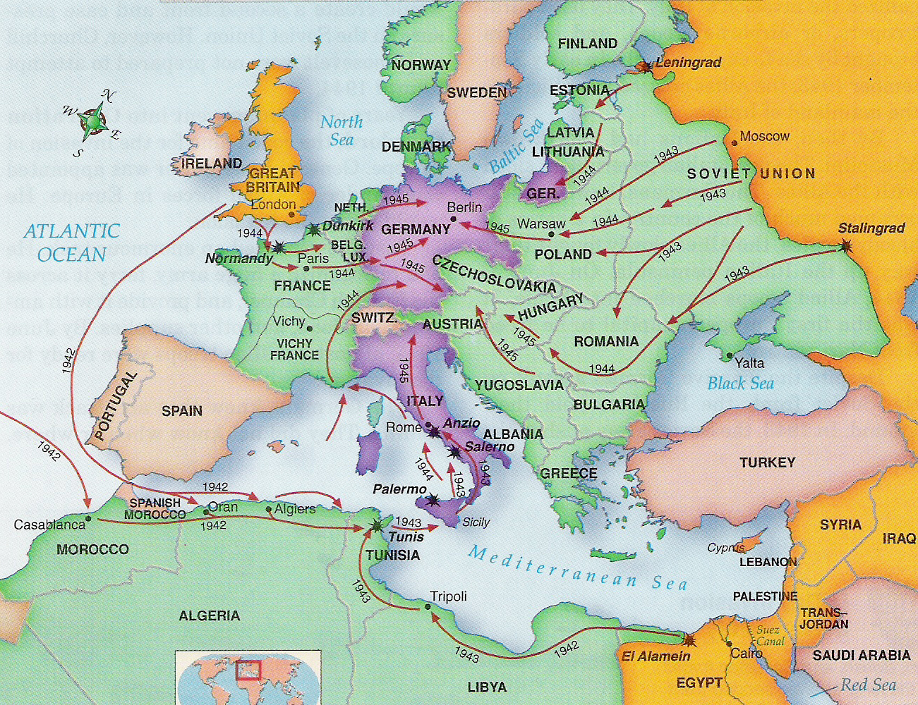
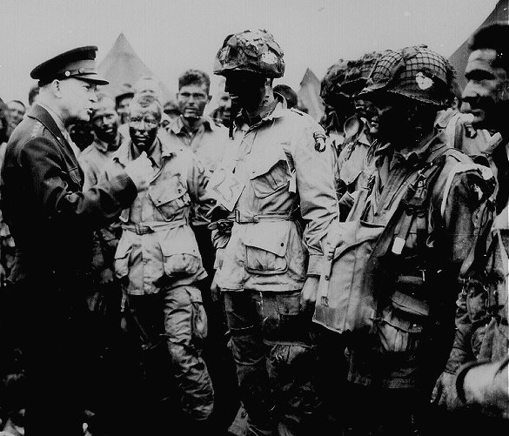
Turning Points: EUROPE
D-Day Invasion of Normandy
General Eisenhower (Allied Supreme Commander) Launched operation Overlord to begin the liberation of France.
The Allies stormed the cliffs of Normandy, France in a bloody assault on German forces
Gen. Eisenhower gives last minute direction to troops before D-Day

Slide 3
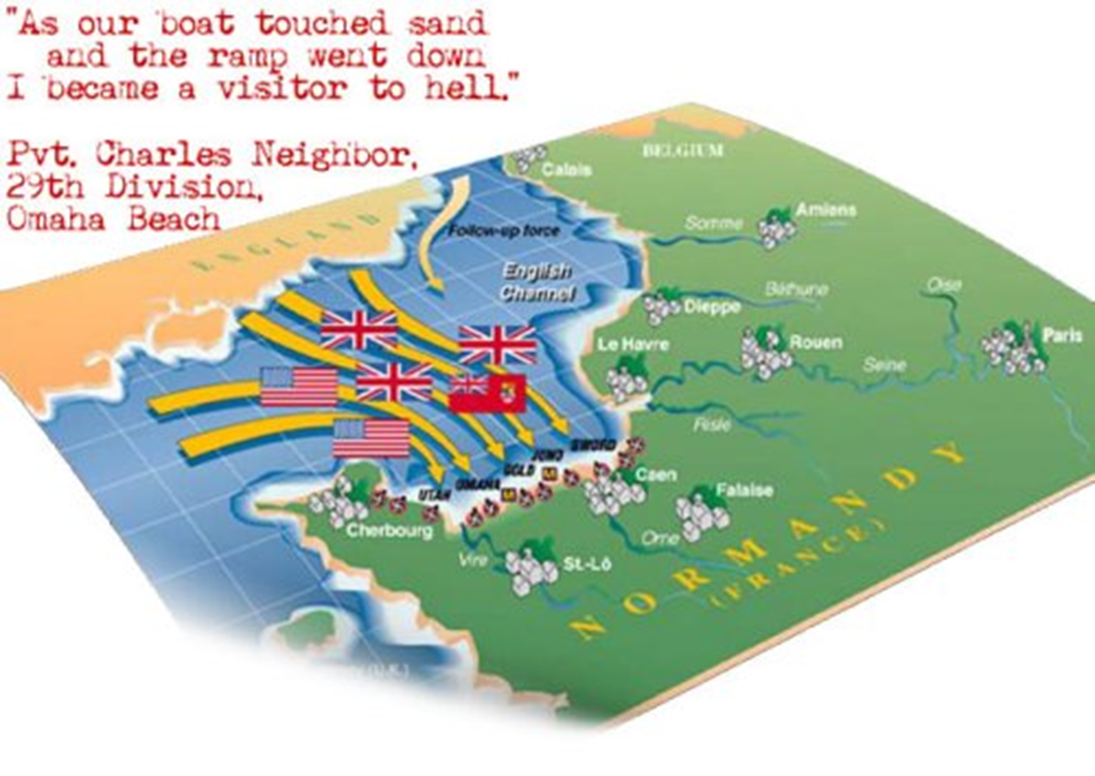
Allied troops plan a massive attack to send 3 million troops across the English Channel.
The plan is to attack Normandy Beach, France.
Many nations helped with this attack.
“Operation Overlord” was the largest air, land, and sea operation undertaken before or since June 6, 1944.
The attack included 5 different points along the beach each given the following code names, Utah, Omaha, Gold, Juno, and Sword.

Slide 4
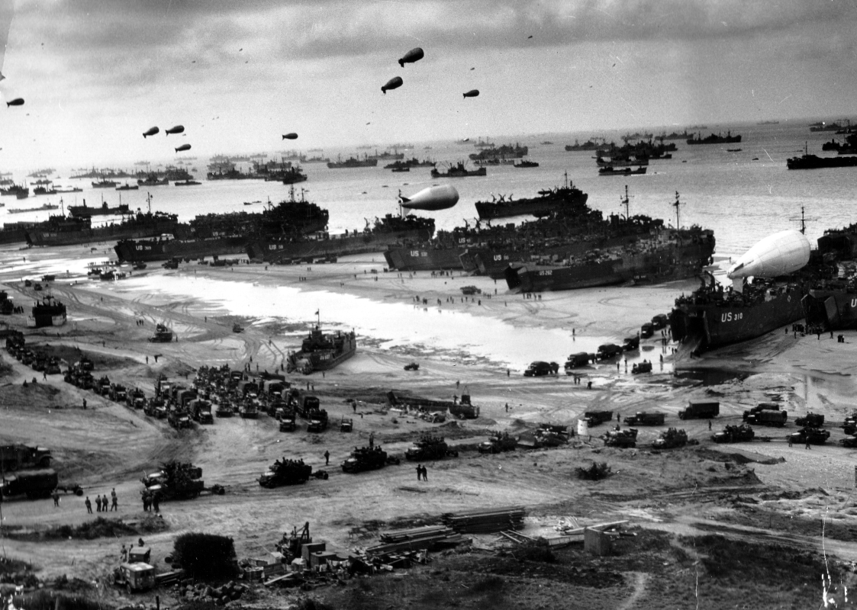
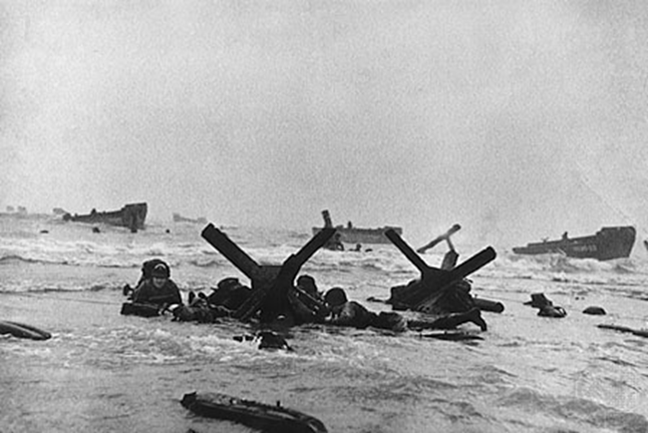
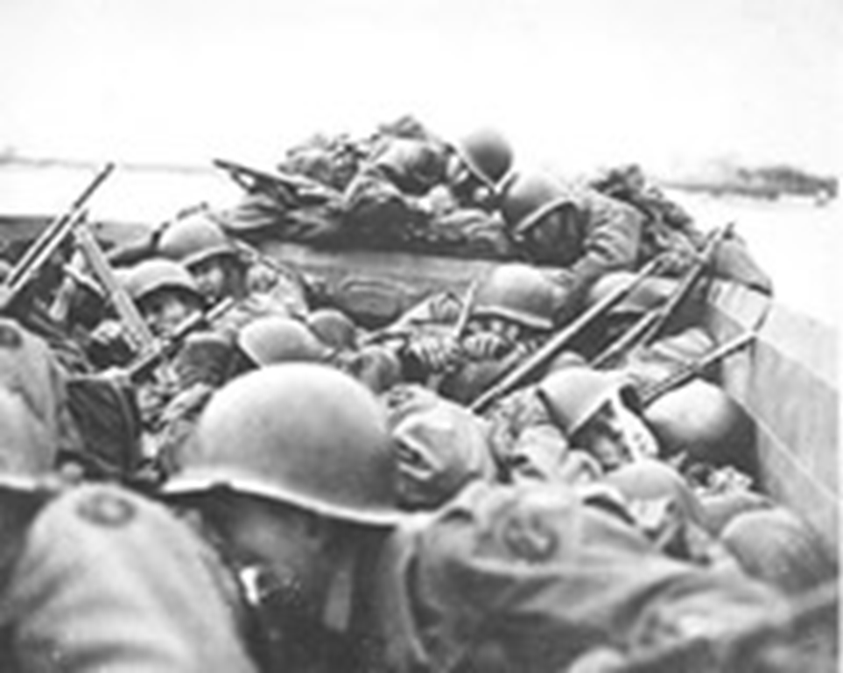
The initial landing included over 5,000 ships, 11,000 airplanes, and over 150,000 service men.
Amphibious landing crafts were developed specifically for this attack
Germany had mined the beaches and covered them with underwater obstacles.

Slide 5
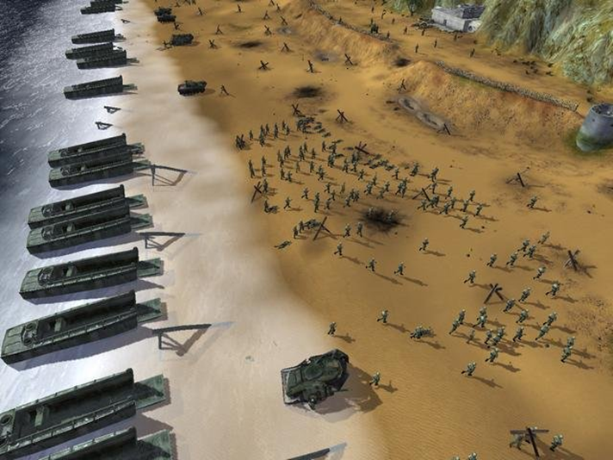
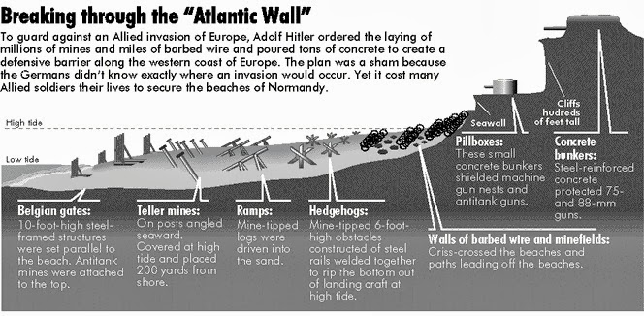
Besides the traps – troops were walking straight into the direct fire from German machine gunners who were hidden from sight and firing down upon the allied troops

Slide 6
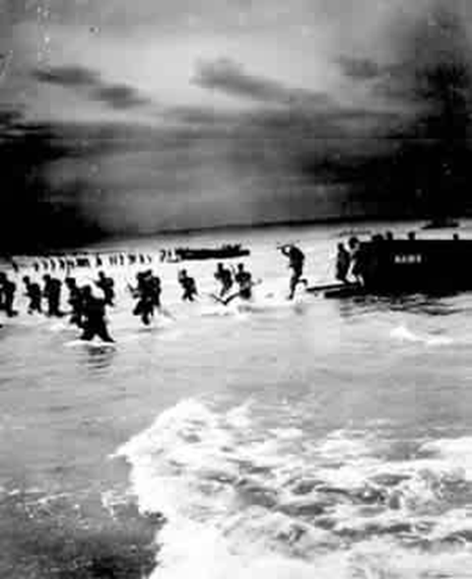
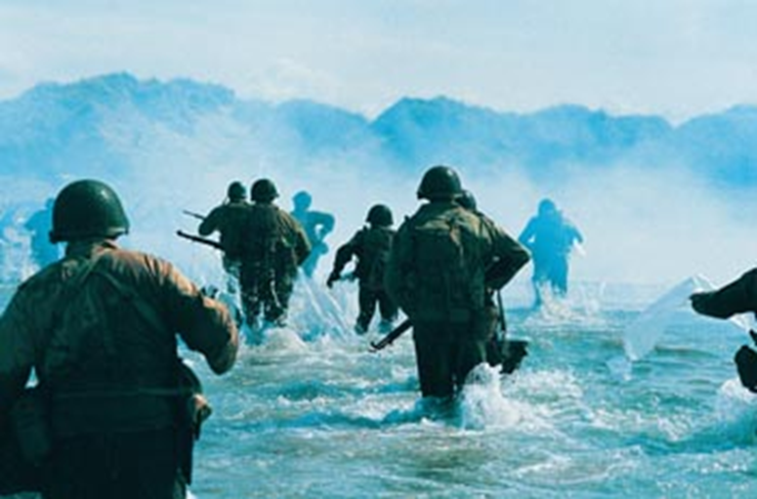
“The boat ramp goes down, then jump, swim, run, and crawl to the cliffs. Many of the first young men (most not yet 20 years old) entered the surf carrying eighty pounds of equipment. They faced over 200 yards of beach before reaching the first natural feature offering any protection. Blanketed by small-arms fire and bracketed by artillery, they found themselves in hell. “

Slide 7
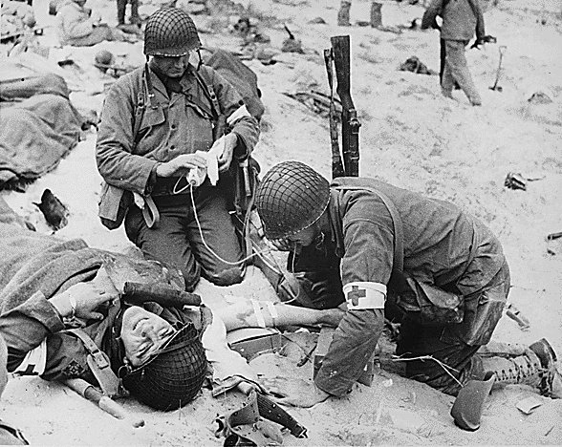
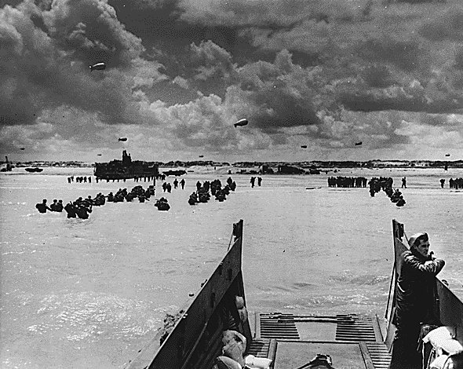
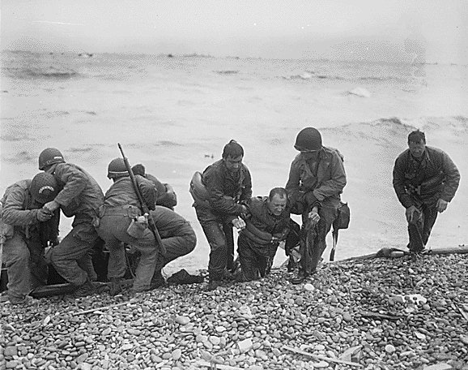
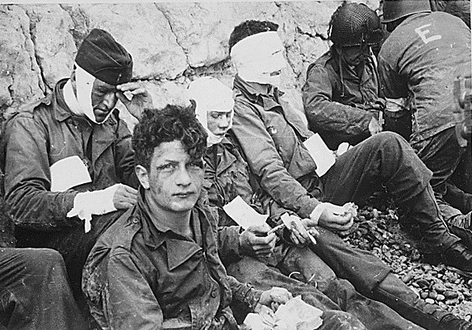
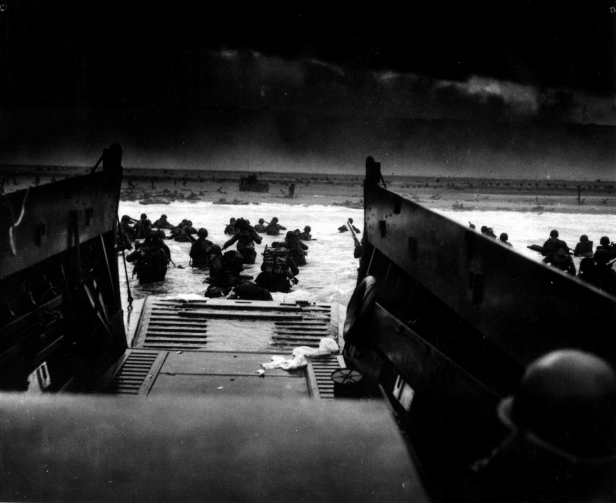
Operation Overlord/D-Day Invasion of Normandy

Slide 8
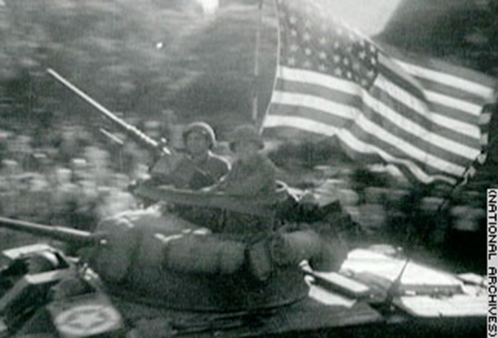
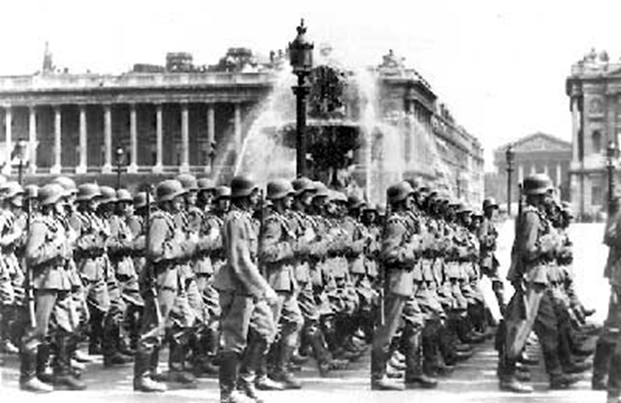
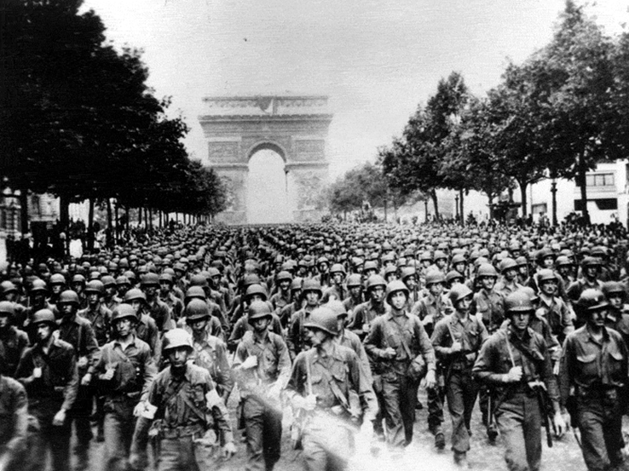
Several more waves of troops continuously crossed the English Channel into France.
By June 30th, over 850,000 men, 148,000 vehicles, and 570,000 tons of supplies had landed on the Normandy shores.
On August 25 1944, the Allies entered Paris.
After 4 years of Nazi Rule Paris and France was liberated.

Slide 9
Battle of the Bulge
On December 16, 1944, German forces began a fierce counterattack
Slowed the Allies advance but did not stop it
At night, British airmen dropped tons of bombs on German cities
By day, Americans bombed factories and oil refineries
Caused severe fuel shortages
Reduced Germany’s ability to produce war goods
German Soldier at Battle of the Bulge

Slide 10
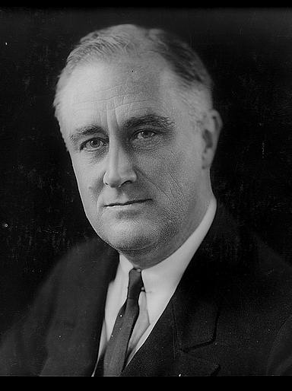
A New President
FDR died early in his fourth term
Vice President Harry S. Truman became President
Truman would later have to make decisions that would end the war

Slide 11
Victory in Europe
By April 1945, Germany was collapsing
American troops were closing in from the west
Soviet troops were closing in from the east
Unwilling to accept defeat, Hitler committed suicide on April 30th
On May 7, Germany surrendered to the allies
On May 8, the Allies celebrated V-E Day (Victory in Europe)
HST announces German surrender

Slide 12
Conclusion
How did the Allies “turn the tide” in WWII? (War in Europe)
After a slow start, the Allies forced Germany to fight on three fronts
Germany’s ability to manufacture war supplies was destroyed by Allied bombing
American manufacturing was able to produce materials for war
Germany’s invasion of the Soviet Union proved to be a great mistake
Germany was unable to fight a multi-front war

Slide 13
https://www.youtube.com/watch?v=APunZ3zeqcY
The Rise and Fall of Nazi Germany, time lapse video

Slide 14
D-Day
America the Story of Us D-Day

