Slide 1
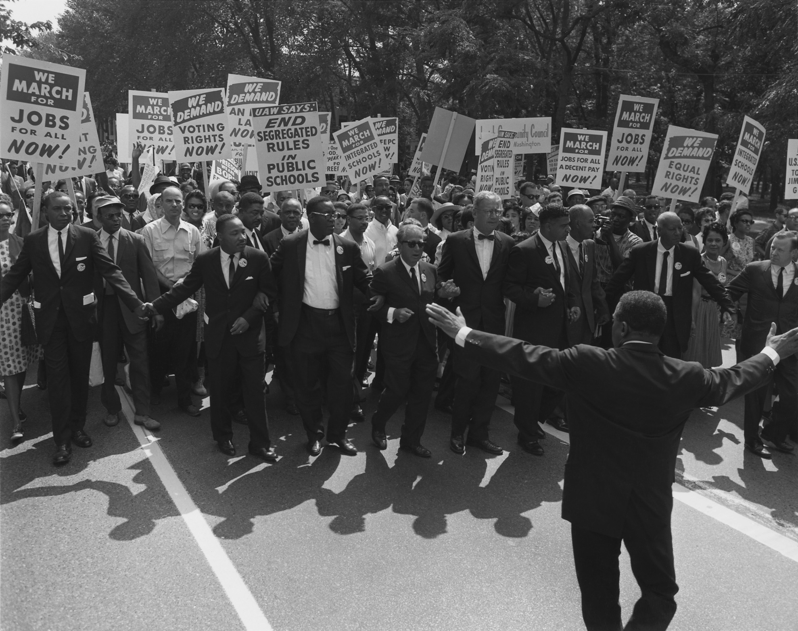
II. Europe Goes to War
CIVIL RIGHTS MOVEMENT
THE

Slide 2
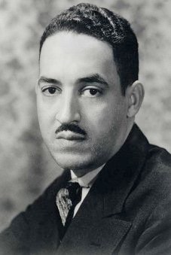
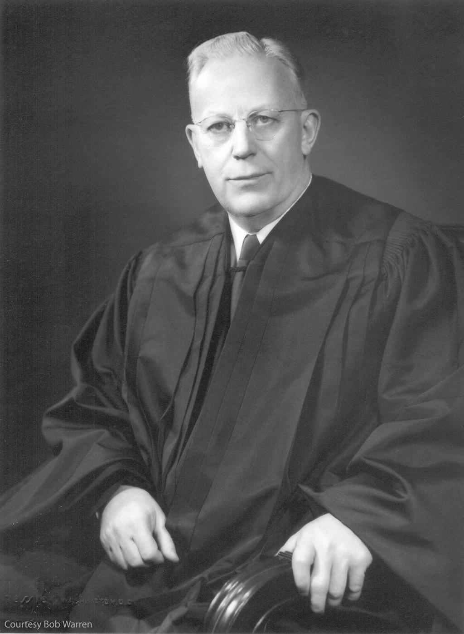
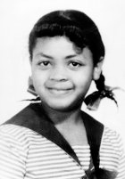
THE
CIVIL RIGHTS MOVEMENT
I. Brown v. Board of Education Topeka
a. Chief Justice Earl Warren -
Ike appointee - argued by Thurgood Marshall(NAACP)
b. Struck down Plessy v. Ferguson (separate but equal clause) under the 14th amendment
c. Brown vs. Board of Ed - Integration of public schools
must happen “with all deliberate
speed.”
Linda Brown
Thurgood Marshall, NAACP 1936
Chief Justice Earl Warren
Notes:
In 1951, Oliver Brown sued the Topeka, Kansas, Board of Education to allow his 8-year old daughter Linda to attend a nearby school that only white children were allowed to attend. She passed the school on her way to the bus that took her to a distant school for African Americans. After appeals, the case reached the Supreme Court. There, Thurgood Marshall argued on behalf of Brown and against segregation in America’s schools. He held that the basic concept of “separate but equal” was inherently unequal. He used statistics to show that black schools were separate and unequal when it came to finances, quality and number of teachers, and physical and educational resources.
---He also read into the record a psychological study indicating that black children educated in a segregated environment suffered from low self-esteem. He stressed that segregated educational facilities, even if physically similar, could never yield equal products.
The court was at a standstill -for a year and half. But then something happens. Chief Justice Fred M. Vinson dies and Eisenhower appoints former Republican governor, Earl Warren to the court. He was a conservative. He pushed for the internment of Japanese Americans during WWII.
But Warren would surprise Eisenhower. .
---On May 17, 1954, in Brown v. Board of Education of Topeka, Kansas, the Supreme Court issued its historic ruling. It was an unanimous vote 9-0. Warren had pushed for a unanimous decision to ensure that a dissenting argument would not be a battle cry for the south
--In a unanimous decision, the Court declared that the “separate but equal” doctrine was unconstitutional and could not be applied to public education. A year later, (Brown II) the court ruled that local school boards should move to desegregate “with all deliberate speed.”
---Eisenhower wasn’t a racist, but didn’t want this case to go forward. He would later say that Earl Warren was “the biggest damn fool mistake I ever made.”

Slide 3
THE
CIVIL RIGHTS MOVEMENT
II. Brown v. Board of Education Topeka
a. Chief Justice Earl Warren -
Ike appointee - argued by Thurgood Marshall(NAACP)
b. Struck down Plessy v. Ferguson (separate but equal clause) under the 14th amdt
c. Brown II - integration of public schools “with all deliberate speed.”
Chief Justice Earl Warren
Notes:
Embedded is an 1:29 minute Brown YouTube video clip, that will begin immediately.
Mac users, click the black circle to open browser and view a 1:29 minute Brown YouTube video clip.
Original Link: https://www.youtube.com/watch?v=YTJhRnzQL9E&feature=youtu.be
In 1951, Oliver Brown sued the Topeka, Kansas, Board of Education to allow his 8-year old daughter Linda to attend a nearby school that only white children were allowed to attend. She passed the school on her way to the bus that took her to a distant school for African Americans. After appeals, the case reached the Supreme Court. There, Thurgood Marshall argued on behalf of Brown and against segregation in America’s schools. He held that the basic concept of “separate but equal” was inherently unequal. He used statistics to show that black schools were separate and unequal when it came to finances, quality and number of teachers, and physical and educational resources.
---He also read into the record a psychological study indicating that black children educated in a segregated environment suffered from low self-esteem. He stressed that segregated educational facilities, even if physically similar, could never yield equal products.
The court was at a standstill -for a year and half. But then something happens. Chief Justice Fred M. Vinson dies and Eisenhower appoints former Republican governor, Earl Warren to the court. He was a conservative. He pushed for the internment of Japanese Americans during WWII.
But Warren would surprise Eisenhower. .
---On May 17, 1954, in Brown v. Board of Education of Topeka, Kansas, the Supreme Court issued its historic ruling. It was an unanimous vote 9-0. Warren had pushed for a unanimous decision to ensure that a dissenting argument would not be a battle cry for the south
--In a unanimous decision, the Court declared that the “separate but equal” doctrine was unconstitutional and could not be applied to public education. A year later, (Brown II) the court ruled that local school boards should move to desegregate “with all deliberate speed.”
-----Eisenhower wasn’t a racist, but didn’t want this case to go forward. He would later say that Earl Warren was “the biggest damn fool mistake I ever made.”

Slide 4
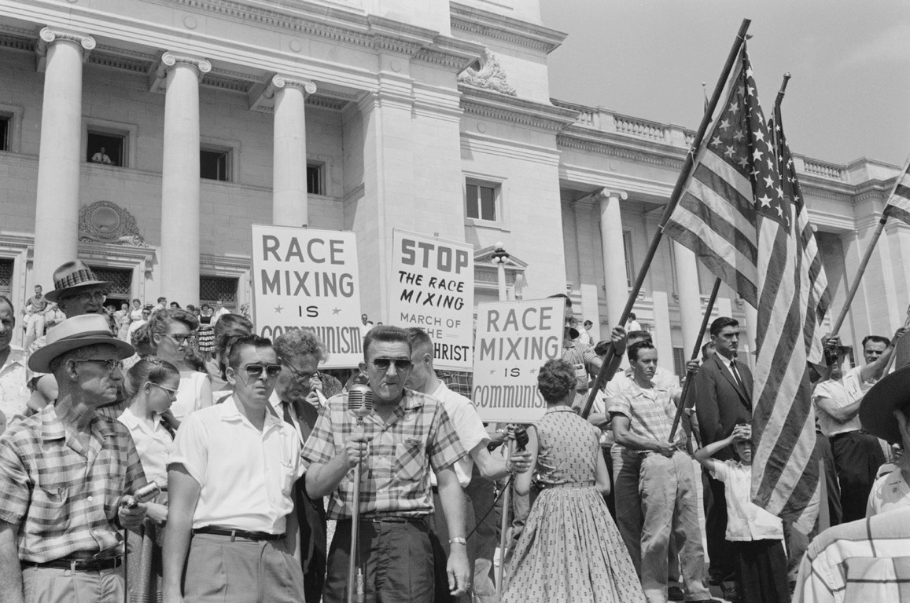
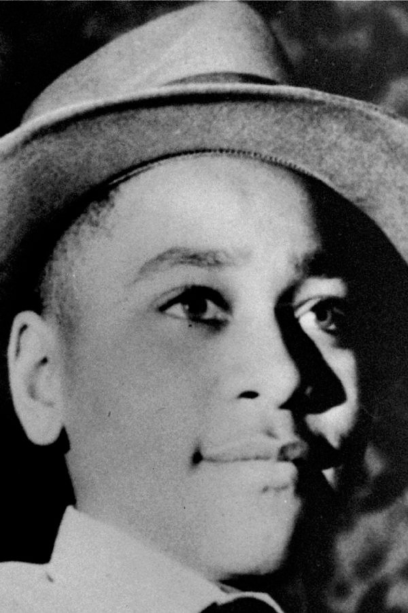
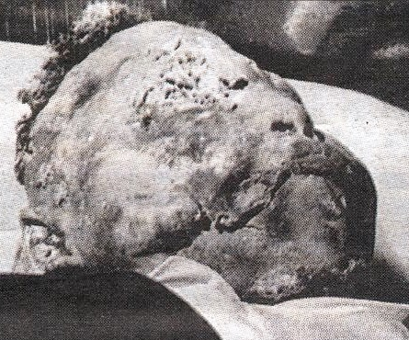
II. Europe Goes to War
CIVIL RIGHTS MOVEMENT
THE
d. Reaction to Brown
- state’s rights issue
- Southern Manifesto - 100 Southern congressmen pledged to oppose Brown.
- Emmet Till - Chicago Black teen killed in Mississippi. Confessed murderers acquitted by all-white jury.
Notes:
Once again the South uses the argument of State’s Rights to defend their treatment of African Americans - they vowed to resist segregation by using all means possible. Virginia passed a law closing any integrated School. Southern Congressmen, in what was called the Southern Manifesto, proudly pledged to oppose the Brown ruling. Consequently, “all deliberate speed” amounted to a snail’s pace. By 1965, only about 2 percent of all southern schools were integrated.
Map Here’s a map showing the change in the Deep South or lack there of. CLICK
MAP: Shows that there WAS now integration within the U.S., but in the DEEP South, nothing had changed in the ten years after Brown.
Ask students which state in 1964 shows the highest increase in the percentage of African Americans attending integrated schools? ANSWER - Texas, Tennessee, Kentucky, Virginia, Maryland, and Delaware.
CLICK Southern white reactions to Brown confirmed to African-Americans that efforts to undo existing social traditions and controls would be met with strong opposition, even violence. An incident in 1955 brought home exactly how far some were willing to go to halt threats to “tradition.’ Emmet Till was a teenager from Chicago visiting relatives in Mississippi. One day he broke “tradition” by approaching and speaking to a white girl without being asked. For his actions, that evening he was tortured and beat. They gouged out one of his eyes, before shooting him through the head and disposing of his body in a nearby river, weighting it with a 70-pound cotton gin fan tied around his neck with barbed wire. (ANOTHER BEFORE AFTER PIC) Two men, Roy Bryant and J.W. Milam were brought to trial and admitted to killing Till. An all-white jury acquitted both men.
THE Verdict was NOT unexpected, but what was a surprise was that black eyewitnesses bravely testified at the trial, despite threats against their lives. It showed that things were beginning to change in the South. Jim Crow was being threatened by black rebellion.

Slide 5
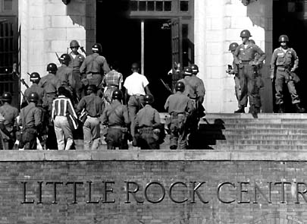
CIVIL RIGHTS MOVEMENT
THE
I. Little Rock -1957
- Gov. Orval Faubus refused integration in Little Rock HS
- President Eisenhower sent Federal troops protecting 9 black students from white mobs “to uphold Federal law & restore order"
- Faubus closed school
- Cooper v. Aaron - barred states from interfering in integration
- many whites flee to all white private schools
Notes:
Southern resistance hit a high in 1957. The Little Rock Arkansas Central High school board had accepted a federal court order to desegregate Central High School, but Arkansas Governor Orval E. Faubus mobilized the state’s National Guard to bar nine African-American students from entering the school. After another court order, withdrew the national guard, but an angry mob of whites blocked the black students entry.
Eisenhower had done everything to avoid the race issue up until this point. He didn’t believe in the Brown decision, he ignored the Montgomery bus boycott, and hinted that it was a state issue. In this case though, he believed he had to uphold FEDERAL Law. He worried about the Soviets exploiting the issue-representing the entire United States, but also that racism in the U.S. impeded efforts to gain the support of nonwhite Third World nations. So, he federalized the Arkansas National Guard and for the first time since Reconstruction, dispatched federal troops to protect black rights. They patrolled Central High for the rest of the year. Faubus shut down Little Rock’s public high schools for two years.
Cooper v. Aaron To prevent such action the Supreme Court ruled in Cooper v. Aaron in 1959, that an African American’s right to attend school could not be nullified openly and directly by state officials nor nullified indirectly by them by evasive schemes for segregation.(like closing a school down)

Slide 6
CIVIL RIGHTS MOVEMENT
THE
I. Little Rock -1957
- Gov. Orval Faubus refused integration in LtRck HS
- Ike sent Fed troops protecting 9 black students from white mobs
- Ike: to uphold Fed law & restore order
- Faubus closed school
- Cooper v. Aaron - barred states from interfering in integration
- many whites flee to all white private schools
Notes:
An embedded link to 4:41 minute Little Rock YouTube video clip begins here.
Mac users, click the black circle to open browser and vide a 4:41 minute Little Rock YouTube video clip.
Original Link: https://www.youtube.com/watch?v=xQZzcW7EzOE&feature=youtu.be
Southern resistance hit a high in 1957. The Little Rock Arkansas Central High school board had accepted a federal court order to desegregate Central High School, but Arkansas Governor Orval E. Faubus mobilized the state’s National Guard to bar nine African-American students from entering the school. After another court order, withdrew the national guard, but an angry mob of whites blocked the black students entry.
Eisenhower had done everything to avoid the race issue up until this point. He didn’t believe in the Brown decision, he ignored the Montgomery bus boycott, and hinted that it was a state issue. In this case though, he believed he had to uphold FEDERAL Law. He worried about the Soviets exploiting the issue-representing the entire United States, but also that racism in the U.S. impeded efforts to gain the support of nonwhite Third World nations. So, he federalized the Arkansas National Guard and for the first time since Reconstruction, dispatched federal troops to protect black rights. They patrolled Central High for the rest of the year. Faubus shut down Little Rock’s public high schools for two years.
Cooper v. Aaron To prevent such action the Supreme Court ruled in Cooper v. Aaron in 1959, that an African American’s right to attend school could not be nullified openly and directly by state officials nor nullified indirectly by them by evasive schemes for segregation.(like closing a school down)

Slide 7
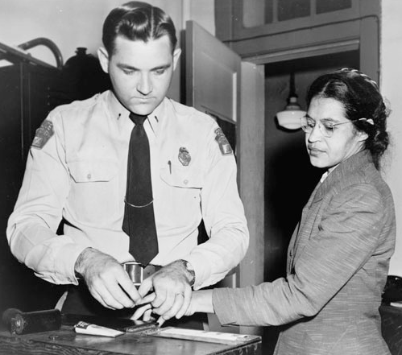
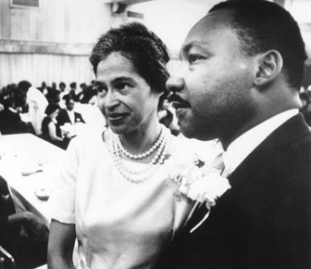
CIVIL RIGHTS MOVEMENT
THE
Montgomery Bus Boycott
- 1955 Rosa Parks & NAACP begin bus boycotts in Montgomery, AL
- 1956 S.Court declares segregation in Public trans. illegal
- makes MLK a Nat’l leader
- MLK forms (SCLC)
Southern Christian Leadership Conference
- goal: massive non-violent protests
Notes:
In 1955, the nations attention shifted from the courts to Montgomery, Alabama. In December, Rosa Parks, a seamstress who had been the secretary of the Montgomery NAACP for 12 years, took a seat in the middle section of the bus, where both African Americans and whites usually were allowed to sit. AAs, however, were expected to give up their seats for white passengers if no available seats remained. When a white man got on at the next stop and had no seat, the bus driver ordered Parks to give up hers. She refused. Even when threatened with arrest, she held her ground. At the next stop, police seized her and ordered her to stand trial for violating the segregation laws.
---Civil rights leaders in Montgomery quickly met and, after Jo Ann Robinson of the Women’s Political Council (WPC) suggested the idea, decided to organize the Montgomery buss boycott. The plan called for African Americans to refuse to use the entire bus system until the bus company agreed to change its segregation policy. Robinson and other members of the WPC, wrote and distributed leaflets announcing the boycott. MLK, the 26 year-old minister of the Baptist church where the original boycott meeting took place, soon became the spokesperson for the protest movement.
---- Over the next year, 50,000 African Americans in Montgomery walked, rode bicycles, or joined car pools to avoid the city buses. Despite losing money, the bus company refused to change its policies. Finally, in 1956, the Supreme Court ruled that bus segregation, like school segregation, was unconstitutional.
---The Montgomery bus boycott encouraged a new generation of leaders in the AA community, most notably, MLK. In addition, it gave minority groups hope that steps toward equality could be made though peaceful protests.
---Weeks after the win, he and other black leaders formed a new civil rights organization, the Southern Christian Leadership Conference. It would become the backbone of the civil rights movement in the 50s and 60s.

Slide 8
CIVIL RIGHTS MOVEMENT
THE
II. Montgomery Bus Boycott
- 1955 Rosa Parks & NAACP begin bus boycotts in Montgomery, AL
- 1956 S.Court declares segregation in Public trans. illegal
- makes MLK a Nat’l leader
- MLK forms (SCLC)
Southern Christian Leadership Conference
- goal: massive non-violent protests
Notes:
An embedded link to a 2:13 minute Montgomery Bus Boycott video clip begins here.
Mac users, click the black circle to open browser and vide a 2:13 minute Montgomery Bus Boycott YouTube video clip.
Original Link: https://www.youtube.com/watch?v=TBSrGNDTN88&feature=youtu.be
In 1955, the nations attention shifted from the courts to Montgomery, Alabama. In December, Rosa Parks, a seamstress who had been the secretary of the Montgomery NAACP for 12 years, took a seat in the middle section of the bus, where both African Americans and whites usually were allowed to sit. AAs, however, were expected to give up their seats for white passengers if no available seats remained. When a white man got on at the next stop and had no seat, the bus driver ordered Parks to give up hers. She refused. Even when threatened with arrest, she held her ground. At the next stop, police seized her and ordered her to stand trial for violating the segregation laws.
---Civil rights leaders in Montgomery quickly met and, after Jo Ann Robinson of the Women’s Political Council (WPC) suggested the idea, decided to organize the Montgomery buss boycott. The plan called for African Americans to refuse to use the entire bus system until the bus company agreed to change its segregation policy. Robinson and other members of the WPC, wrote and distributed leaflets announcing the boycott. MLK, the 26 year-old minister of the Baptist church where the original boycott meeting took place, soon became the spokesperson for the protest movement.
---- Over the next year, 50,000 African Americans in Montgomery walked, rode bicycles, or joined car pools to avoid the city buses. Despite losing money, the bus company refused to change its policies. Finally, in 1956, the Supreme Court ruled that bus segregation, like school segregation, was unconstitutional.
---The Montgomery bus boycott encouraged a new generation of leaders in the AA community, most notably, MLK. In addition, it gave minority groups hope that steps toward equality could be made though peaceful protests.
---Weeks after the win, he and other black leaders formed a new civil rights organization, the Southern Christian Leadership Conference. It would become the backbone of the civil rights movement in the 50s and 60s.

