Slide 1
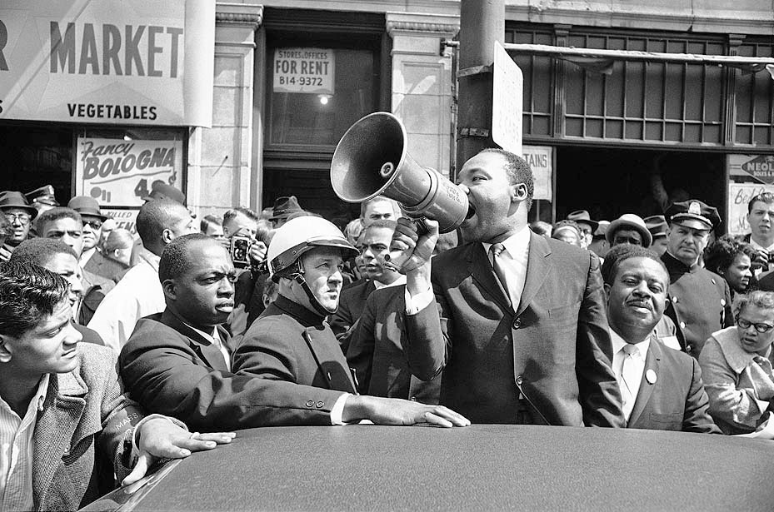
CIVIL RIGHTS MOVEMENT
THE
Northern Segregation
- de facto segregation - segregation by practice and custom
- blacks lived in decaying
slums
“white flight” in suburbs
- high unemployment
- poor schools
- Race Riots breakout in Harlem & Watts-Las Angeles. - 100 cities
- King marches in Northern cities
Civil Rights Act of 1968 – prohibited discrimination in the sale, rental & financing of housing
Notes:
The problem facing African Americans in the North was de facto segregation - segregation that exists by practice and custom. de facto segregation is harder to fight than segregation in the south because it requires changing people’s attitudes rather than repealing laws. It’s harder to convince whites to share economic power and social power than a drinking fountain or a bathroom.
This segregation in the North begins when African Americans from the South move to the North after WWII. You have “white flight” - whites moving from the cities to the suburbs, leaving blacks in a crumbling inner city. They paid rent to land lords who didn’t comply with housing and health ordinances.
• unemployment twice as much as whites
Schools for Black children deteriorated along with their neighborhoods. Unemployment rates were more that twice as high as those among whites.
**Research showed that segregated neighborhoods were created by real estate agents that wouldn’t show African American homes in white neighborhoods.
MLK takes his marches from the South to the North. They in Northern cities like Boston and Chicago and face the same opposition that thy did in the South. Bottles and rocks were thrown at the marchers. King, who received death threats throughout his involvement in the civil rights movement, was hit by a brick during one march but continued to lead marches in the face of personal danger
In NYC in July of ’64, and encounter between white police and African American teenagers ended in the death of a 15-year old student. This sparked a race riot in central Harlem. Watts Los Angeles were the worse riots in our history. 34 people killed - hundreds of millions of dollars worth of property was destroyed.
Johnson and many whites were baffled by the fact that blacks were rioting, especially after the civil rights bill was passed. They didn’t realize that much of the rioting came out of inequalities that came in the form of poverty, education, and unemployment.

Slide 2
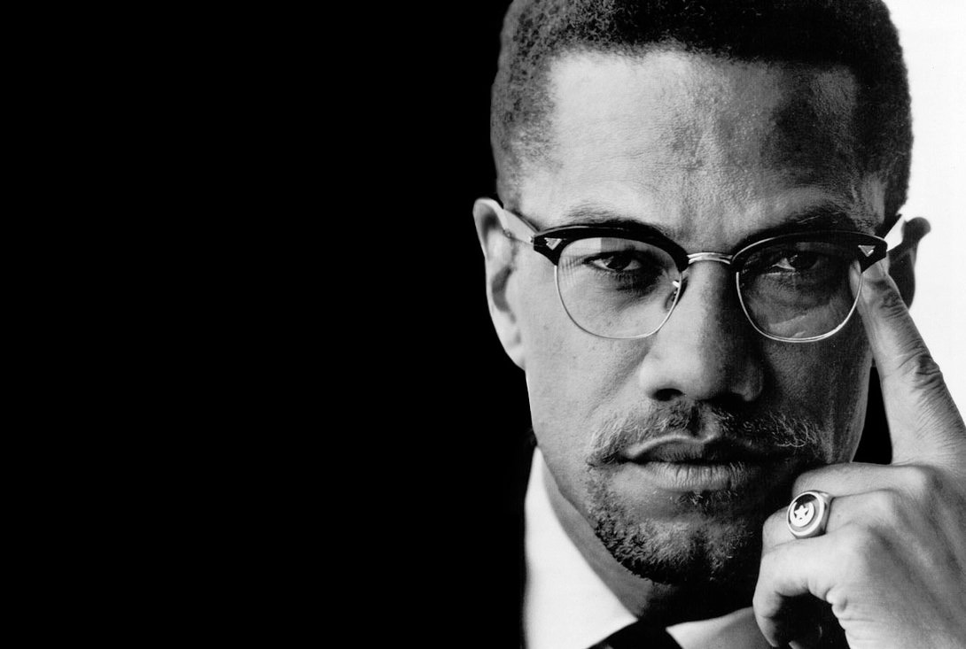
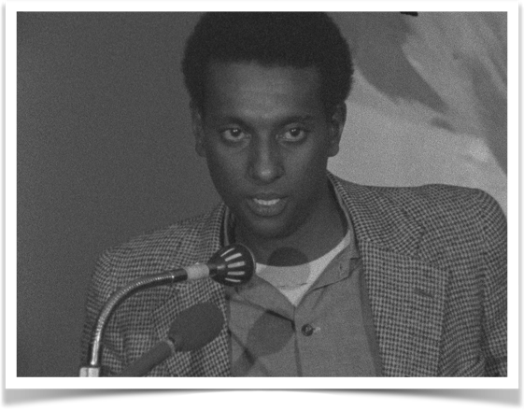
CIVIL RIGHTS MOVEMENT
THE
Northern Segregation
- Malcolm X - Black Muslim who advocated armed resistance & black pride.
- Stokely Carmichael - Leader of SNCC & the Black Power movement
- Black Power - movement in support of rights & political power African Americans.
- Black Panther Party - Est. by Huey Newton & Bobby Seale
- practiced militant self-
defense
- aid black communities w/
daycare, medical clinics,
free breakfast programs
“call for black people to begin to define their own goals....(and) to lead their own organizations”
Notes:
People were frustrated with the limits of nonviolent protests and slow politics. They wanted more. Younger members of SNCC and inner city youth were attracted to new civil rights activists who advocated violence.
1. Malcolm X - Born Malcolm Little, X was a troubled youth who ended up in prison. While in prison he found God - or Allah. He became Muslim and changed his name to Malcolm X. Little, he claimed was his slave name. Out of prison he became a Islamic minister in the nation of Islam. He preached that whites were the cause of all Black problems and against integration. Blacks should be separate from white society. Trip to Mecca -
Stokely Carmichael was the head of SNCC. He had been listening to leaders like Malcolm X and increasingly separatist.

Slide 3
CIVIL RIGHTS MOVEMENT
THE
Northern Segregation
- Malcolm X - Black Muslim who advocated armed resistance & black pride.
- Stokely Carmichael - Leader of SNCC & the Black Power movement
- Black Power - movement in support of rights & political power African Americans.
- Black Panther Party - Est. by Huey Newton & Bobby Seale
- practiced militant self-
defense
- aid black communities w/
daycare, medical clinics,
free breakfast programs
Notes:
An embedded link to 2:12 minute Malcolm X YouTube video clip begins here.
Mac users, click the black circle to open browser and video 2:12 minute Malcolm X YouTube video clip.
Original Link: https://www.youtube.com/watch?v=km_uEnI4UD0&feature=youtu.be
People were frustrated with the limits of nonviolent protests and slow politics. They wanted more. Younger members of SNCC and inner city youth were attracted to new civil rights activists who advocated violence.
1. Malcolm X - Born Malcolm Little, X was a troubled youth who ended up in prison. While in prison he found God - or Allah. He became Muslim and changed his name to Malcolm X. Little, he claimed was his slave name. Out of prison he became a Islamic minister in the nation of Islam. He preached that whites were the cause of all Black problems and against integration. Blacks should be separate from white society. Trip to Mecca -
Stokely Carmichael was the head of SNCC. He had been listening to leaders like Malcolm X and increasingly separatist.

Slide 4
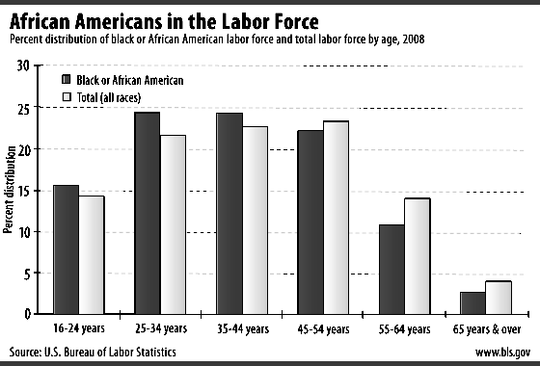
CIVIL RIGHTS MOVEMENT
THE
Movement’s Legacy
a. King Assassinated - 4/3/68
- Riots in every major city in the U.S.
b. Success
- Desecration, voter rights, outlaw of housing discrimination
- Problems
- “white flight”
- unemployment
- poverty
Notes:
In April 1968, a James Earl Ray shot and killed Martin Luther King, Jr., in Memphis, Tennessee. Many leaders called for peace. But anger over King’s death led many African Americans to riot. Cities across the nation erupted in violence.
In June of the same year, a 22-year-old Palestinian, Sirhan Sirhan shot and killed Senator Robert Kennedy. Kennedy was a strong supporter of civil rights.

