Slide 1
CIVIL RIGHTS MOVEMENT
THE
Freedom Summer
- attempted to register voters in Mississippi
- Blacks: 42% population
5% of voters
- 3 people murdered by KKK
Notes:
Meanwhile the rights for African Americans to vote still didn’t exist in large parts of the South. In 1964 CORE and SNCC workers in the South began registering as many African Americans as they could to vote. They hoped their work would gain national attention like the protests in Albany and Birmingham. This would put pressure on Congress to pass a voter rights act. They focused on Mississippi and it was called Freedom Summer. The KKK held rallies to intimidate the volunteers. In August FBI agents found the bodies of three civil rights workers. Civil rights leaders reported three deaths, 35 shootings, 30 fire bombings and 80 mob attacks. A thousand volunteers were arrested.

Slide 2
CIVIL RIGHTS MOVEMENT
THE
Freedom Summer
- attempted to register voters in MS
- Blacks: 42% population
5% of voters
- 3 people murdered by KKK
Notes:
An embedded link to a 2:44 minute Freedom Summer YouTube video clip begins here.
Mac users, click the black circle to open browser and video 2:44 minute Freedom Summer YouTube video clip.
Original Link: https://www.youtube.com/watch?v=Kx9iIEMV878&feature=youtu.be
Meanwhile the rights for African Americans to vote still didn’t exist in large parts of the South. In 1964 CORE and SNCC workers in the South began registering as many African Americans as they could to vote. They hoped their work would gain national attention like the protests in Albany and Birmingham. This would put pressure on Congress to pass a voter rights act. They focused on Mississippi and it was called Freedom Summer. The KKK held rallies to intimidate the volunteers. In August FBI agents found the bodies of three civil rights workers. Civil rights leaders reported three deaths, 35 shootings, 30 fire bombings and 80 mob attacks. A thousand volunteers were arrested.

Slide 3
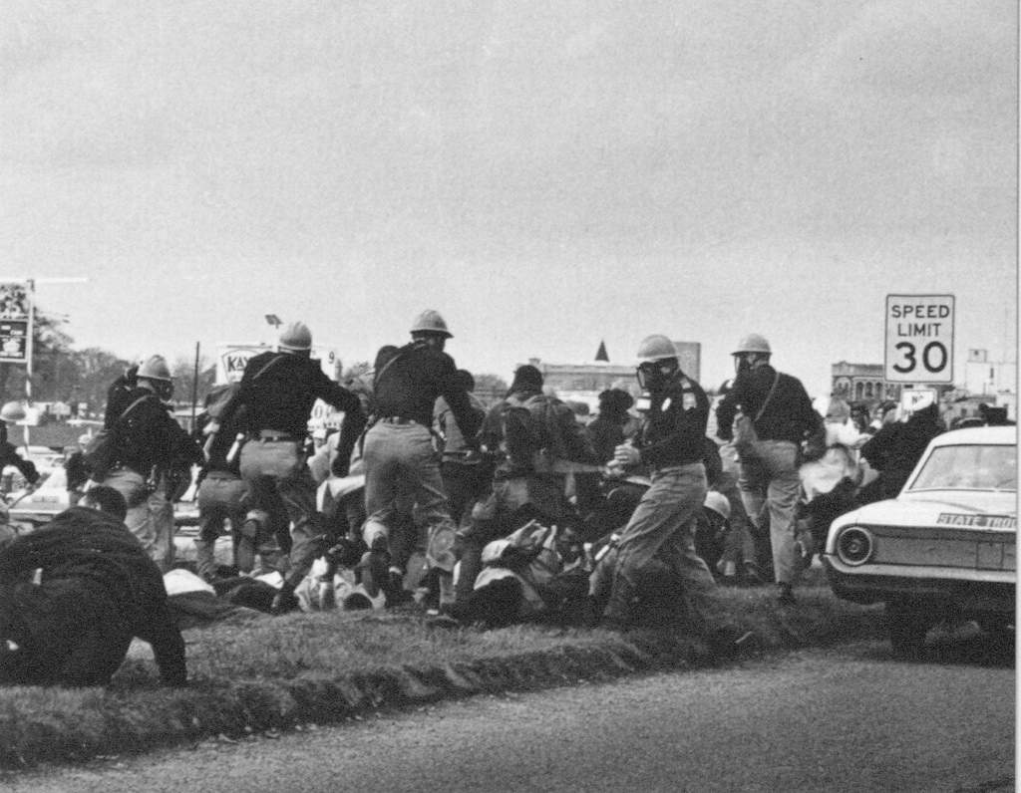
CIVIL RIGHTS MOVEMENT
THE
Selma, AL
- March for Voter Rights Act
- from Selma to Montgomery, turns violent
- Johnson signed the Voting Rights Act of 1965 - poll taxes, literacy tests illegal
- gave Fed Govt power to register voters where locals prevented blacks from voting.
- By 1968 - 1 million blacks registered to vote
- 1st time since reconstruction, blacks elected to local, state & national offices
Notes:
At the beginning of 1964, the SCLC and SNCC had been working to register voters. 2,000 African American demonstrators had been arrested. After one demonstrator named Jimmy Lee Jackson was shot and killed MLK responded by announcing a 50 mile protest march from Selma to Montgomery, the state capital, of Alabama. Again Television cameras were there to capture the scene. CLICK

Slide 4
CIVIL RIGHTS MOVEMENT
THE
Selma, AL
- March for Voter Rights Act
- from Selma to Montgomery turns violent
- Johnson signed the Voting Rights Act of 1965 - poll taxes, literacy tests illegal
- gave Fed Govt power to register voters where locals prevented blacks from voting.
- By 1968 - 1 million blacks registered to vote
- 1st time since reconstruction, blacks elected to local, state & national offices
Notes:
An embedded link to a 4:51 minute Selma YouTube video clip begins here.
Mac users, click the black circle to open browser and video 4:51 minute Selma YouTube video clip.
Original Link: https://www.youtube.com/watch?v=_eK4UHjhNLc&feature=youtu.be
At the beginning of 1964, the SCLC and SNCC had been working to register voters. 2,000 African American demonstrators had been arrested. After one demonstrator named Jimmy Lee Jackson was shot and killed MLK responded by announcing a 50 mile protest march from Selma to Montgomery, the state capital, of Alabama. Again Television cameras were there to capture the scene. CLICK

