Slide 1
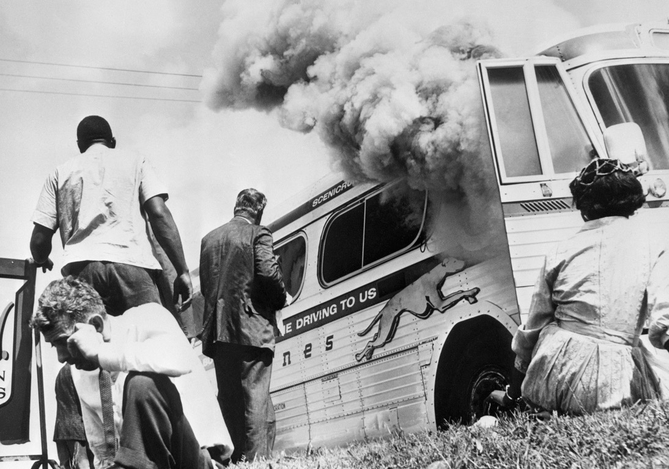
CIVIL RIGHTS MOVEMENT
THE
Freedom Riders
- Freedom Riders – Black & White civil rights activists who rode national busses into the deep south.
- South reacted w/violence against the riders
- Gained National attention -
Fed. Gov’t banned segregation in all travel facilities including waiting rooms, rest rooms, & lunch counters.
Albany Movement
Goal: Desegregate Albany,GA
- Martin Luther King arrested twice
- Arrested so many, movement ran out of protestors
- It FAILED
Notes:
In 1961, CORE members went on a historic bus trip across the South. The trip consisted of two buses were filled with both whites and blacks and their goal was to test a Supreme Court decision that banned segregated seating on interstate bus routes and segregated facilities in bus terminals. Those people on the two busses would become called freedom riders. They were trying to provoke a violent reaction that would convince the Kennedy administration to enforce the law.
At the Alabama state line, white racists got on the Bus number one carrying chains, brass knuckles and pistols. They brutally beat African American riders and white activists who tried to intervene. Still the riders continued. Then on May 4 1961, Mother’s Day, the buss pulled into the Birmingham bus terminal. Bus number one was attacked by a mob holding iron bars. That was the end of Bus number One. Bus Number two continued on. IN Anniston, Alabama, about 200 angry whites attacked Bus Two. The mob followed the activists out of town. When one of the tires blew, they smashed a window and tossed in a fire bomb. The freedom riders spilled out just before the bus exploded.
----New volunteers and new busses were sent to the south. In Birmingham, policemen pulled them from the bus, beat them, and drove them into Tennessee. The bus driver then stopped in in Tennessee and refused to drive on scared for his life. In protest, the passengers occupied the WHITES-ONLY waiting room at the terminal for eighteen hours until Robert Kennedy called the bus company to convince the driver to proceed. They set out for Montgomery, Alabama. Officials in Alabama had promised Kennedy that the riders would be protected. But they lied. An angry mob armed with bats and lead pipes pulled the riders out and beat them. There wasn’t a cop in sight.
---It worked. Newspapers across the country and around the world denounced the beatings. President Kennedy sent 400 U.S. marshals to protect the riders on the last part of their journey to Jackson, Mississippi. In addition, he banned segregation in all interstate travel factitious, including waiting rooms, restrooms and lunch counters.

Slide 2
CIVIL RIGHTS MOVEMENT
THE
III. Freedom Riders
- Freedom Riders - B/W civil rights activists who rode nat’l busses into the deep south.
- South reacted w/violence against the riders
- Gained Nat’l attention -
Fed Gov’t banned segregation in all travel facilities including waiting rooms, rest rooms, & lunch counters.
III. Albany Movement
- Goal: Desegregate Albany,GA
- King arrested twice
- Arrested so many, movement ran out of protestors
- It FAILED
Notes:
An embedded link to a 2:44 minute Freedom Summer YouTube video clip begins here.
Mac users, click the black circle to open browser and vide a 2:44 minute Freedom Summer YouTube video clip.
Original Link: https://youtu.be/sdlmKzLYq6Q
In 1961, CORE members went on a historic bus trip across the South. The trip consisted of two buses were filled with both whites and blacks and their goal was to test a Supreme Court decision that banned segregated seating on interstate bus routes and segregated facilities in bus terminals. Those people on the two busses would become called freedom riders. They were trying to provoke a violent reaction that would convince the Kennedy administration to enforce the law.
At the Alabama state line, white racists got on the Bus number one carrying chains, brass knuckles and pistols. They brutally beat African American riders and white activists who tried to intervene. Still the riders continued. Then on May 4 1961, Mother’s Day, the buss pulled into the Birmingham bus terminal. Bus number one was attacked by a mob holding iron bars. That was the end of Bus number One. Bus Number two continued on. IN Anniston, Alabama, about 200 angry whites attacked Bus Two. The mob followed the activists out of town. When one of the tires blew, they smashed a window and tossed in a fire bomb. The freedom riders spilled out just before the bus exploded.
----New volunteers and new busses were sent to the south. In Birmingham, policemen pulled them from the bus, beat them, and drove them into Tennessee. The bus driver then stopped in in Tennessee and refused to drive on scared for his life. In protest, the passengers occupied the WHITES-ONLY waiting room at the terminal for eighteen hours until Robert Kennedy called the bus company to convince the driver to proceed. They set out for Montgomery, Alabama. Officials in Alabama had promised Kennedy that the riders would be protected. But they lied. An angry mob armed with bats and lead pipes pulled the riders out and beat them. There wasn’t a cop in sight.
---It worked. Newspapers across the country and around the world denounced the beatings. President Kennedy sent 400 U.S. marshals to protect the riders on the last part of their journey to Jackson, Mississippi. In addition, he banned segregation in all interstate travel factitious, including waiting rooms, restrooms and lunch counters.

Slide 3
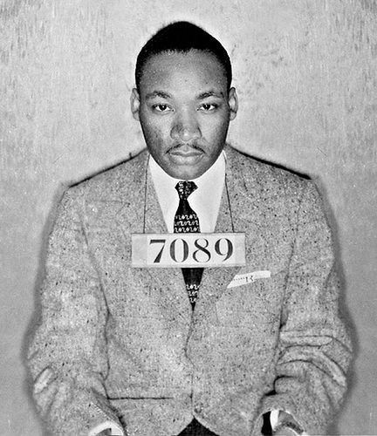
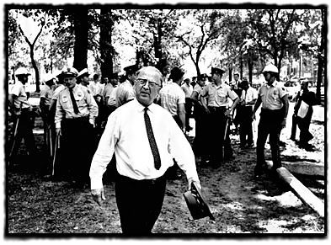
CIVIL RIGHTS MOVEMENT
THE
Birmingham, AL
- Goal: Desegregate Birmingham, AL
- Strategy: Anger Chief of Police - Bull Connor
- King arrested - writes “Letter from a Birmingham Jail”
- fire hoses, clubs, & dogs on students
- Nat’l news shocked the country
- MLK wins
- weeks later 4 girls die in church bombing
For years now I have heard the word “Wait!” It rings in the ear of every Negro with a piercing familiarity. This “Wait” has almost always meant “Never.” We must come to see, with one of our distinguished jurists, that “justice too long delayed is justice denied”
Notes:
Birmingham, Alabama was the most segregated city in the country. It was known for its strict enforcement of total segregation in public life - in schools restaurants, city parks and department store dressing rooms. Although African Americans constituted more than 40% of Birmingham’s population, fewer than 10,000 of 80,000 voters were black. It was also known for racial violence, including 18 bombings from 1957 to 1963.
Martin Luther King, Jr and his SCLC allies including Reverend Fred Shuttlesworth developed the strategy to fill the city jails with protesters, boycott downtown department stores and enrage Chief of police, Eugene “Bull” Connor. He was known for violence.
King demanded 1. an end to racist hiring practices, 2. end of segregation public accommodations
3. the creation of a biracial committee to oversee the desegregation.
During the protests King and many others were arrested. King himself was put in solitary confinement for several days. He wrote an open letter to leaders who felt his movement was trying to move too fast. It was snuck out of prison and reprinted in newspapers around the U.S. (CLICK)
Television cameras recorded the scenes of appalling violence for people around the country. Even those who didn’t care for the civil rights movement were revolted. and In the End, King and the protesters won. Birmingham had been desegregated. Non-Violence worked - It wouldn’t work every time - But in Birmingham, Alabama it had proved itself.

Slide 4
CIVIL RIGHTS MOVEMENT
THE
IV. Birmingham, AL
- Goal: Desegregate Birmingham, AL
- Strategy: Anger Chief of Police - Bull Connor
- King arrested - writes “Letter from a Birmingham Jail”
- fire hoses, clubs, & dogs on students
- Nat’l news shocked the country
- MLK wins
- weeks later 4 girls die in church bombing
Notes:
An embedded link to a 2:46 minute Birmingham YouTube video clip begins here.
Mac users, click the black circle to open browser and vide a 2:46 minute Birmingham YouTube video clip.
Original Link: https://www.youtube.com/watch?v=VAJPDT1if10&feature=youtu.be
Birmingham, Alabama was the most segregated city in the country. It was known for its strict enforcement of total segregation in public life - in schools restaurants, city parks and department store dressing rooms. Although African Americans constituted more than 40% of Birmingham’s population, fewer than 10,000 of 80,000 voters were black. It was also known for racial violence, including 18 bombings from 1957 to 1963.
Martin Luther King, Jr and his SCLC allies including Reverend Fred Shuttlesworth developed the strategy to fill the city jails with protesters, boycott downtown department stores and enrage Chief of police, Eugene “Bull” Connor. He was known for violence.
King demanded 1. an end to racist hiring practices, 2. end of segregation public accommodations
3. the creation of a biracial committee to oversee the desegregation.
During the protests King and many others were arrested. King himself was put in solitary confinement for several days. He wrote an open letter to leaders who felt his movement was trying to move too fast. It was snuck out of prison and reprinted in newspapers around the U.S. (CLICK)
Television cameras recorded the scenes of appalling violence for people around the country. Even those who didn’t care for the civil rights movement were revolted. and In the End, King and the protesters won. Birmingham had been desegregated. Non-Violence worked - It wouldn’t work every time - But in Birmingham, Alabama it had proved itself.

Slide 5
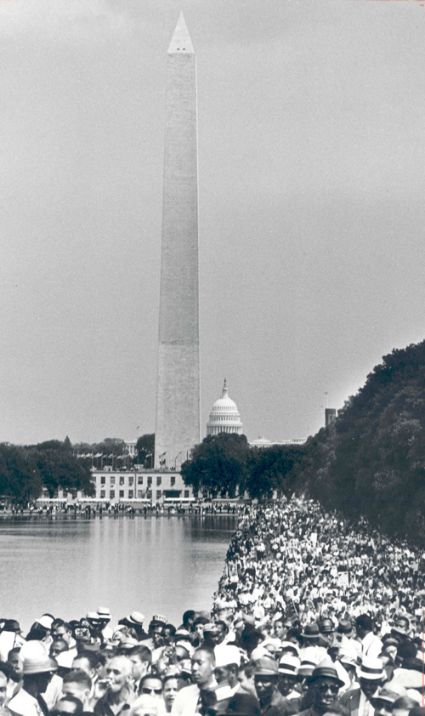
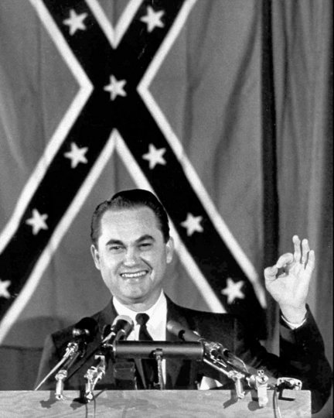
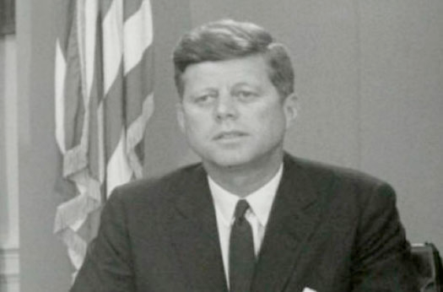
CIVIL RIGHTS MOVEMENT
THE
JFK & The March on Washington
- June 1963 Governor George Wallace of Alabama stops 2 black students from entering U. of Alabama
- JFK sends troops
- Medgar Evers(leader of Mississippi NAACP) shot/killed in driveway
- JFK pushes congress to pass his Civil Rights Bill
- To support the bill - leaders call on a March on Washington - MLK’s “I Have a Dream Speech”
Governor George Wallace
Notes:
Civil rights leaders proposed a march on Washington to lobby for passage of Kennedy’s civil rights bill. Kennedy actually tried to stop the march - He told king the march could anger Congress who he had to convince to pass the bill and the march might result in serious racial violence. King and other leaders ignored Kennedy and went through with it. Kennedy finally supported the march.
The March on Washington took place in August of 1963. More than 250,000 people came from all over the country, including around 75,000 whites. Civil rights leaders all gave speeches at the march and this is where MLK delivered what was to become his best-known address, his I have a dream speech. Kennedy watch the speech from his TV and was impressed, but Congress still wouldn’t pass his civil rights bill.

Slide 6
CIVIL RIGHTS MOVEMENT
THE
V. JFK & March of Washington
- 6/1963 Governor George Wallace of Alabama stops 2 black students from entering U. of Alabama
- JFK sends troops
- Medgar Evers(leader of MS NAACP) shot/killed in driveway
- JFK pushes congress to pass his Civil Rights Bill
- To support the bill - leaders call on a March on Washington - MLK’s “I Have a Dream Speech”
Notes:
An embedded link to a 3:18 minute March on Washington YouTube video clip begins here.
Mac users, click the black circle to open browser and video 3:18 minute March on Washington YouTube video clip.
Original Link: https://www.youtube.com/watch?v=tSWZEay0kWI&feature=youtu.be
Civil rights leaders proposed a march on Washington to lobby for passage of Kennedy’s civil rights bill. Kennedy actually tried to stop the march - He told king the march could anger Congress who he had to convince to pass the bill and the march might result in serious racial violence. King and other leaders ignored Kennedy and went through with it. Kennedy finally supported the march.
The March on Washington took place in August of 1963. More than 250,000 people came from all over the country, including around 75,000 whites. Civil rights leaders all gave speeches at the march and this is where MLK delivered what was to become his best-known address, his I have a dream speech. Kennedy watch the speech from his TV and was impressed, but Congress still wouldn’t pass his civil rights bill.

Slide 7
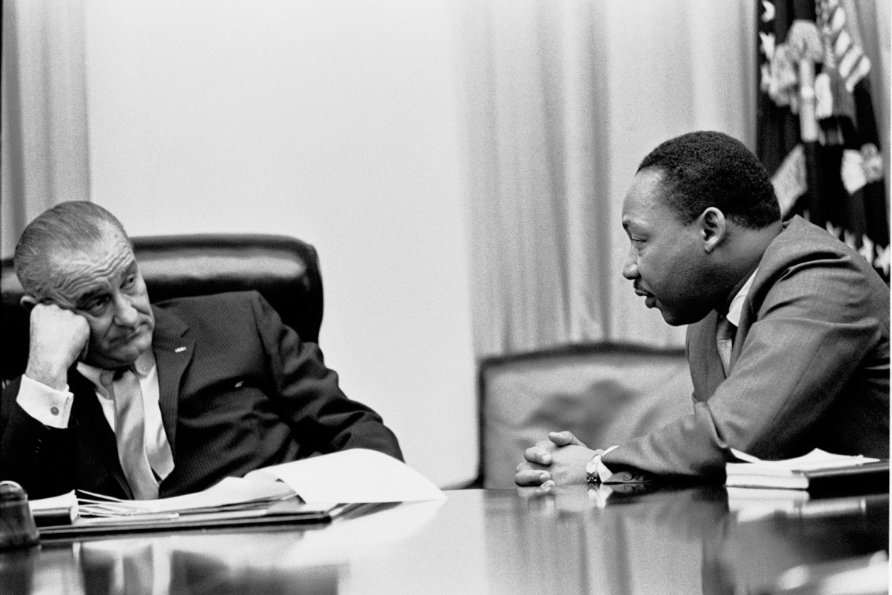
CIVIL RIGHTS MOVEMENT
THE
Johnson & Civil Rights Act of 1964
- July 2, 1964 Johnson signs the Civil Rights Act
- most important act since Reconstruction
- Banned discrimination in public facilities & employment based on race, color, religion, sex or national origin.
Notes:
Three Months after the March on Washington, President Kennedy was dead and his civil rights bill was not passed. Just five days after Kennedy’s death Johnson gives a speech pushing for the passing of JFK’s civil rights bill.(Click)
Johnson hadn’t always been a civil rights believer. As a congressmen, he had voted against civil rights legislation, but as a Senator he had pushed civil rights legislation. Johns let congress know that he would accept a compromise on Civil rights. After it pass the congress, it had to pass the Senate. Southern members of the Senate filibustered the bill, but Johnson was able to arm-twist an old friend to cut off the filibuster. Finally the bill passed.
The Civil rights bill of 1964 banned discrimination in all public accommodations and gave the Justice Department authority to act more vigorously in school segregation and voting rights cases. It also included an equal opportunity provision that prohibited discrimination in hiring based on race, sex, religion or national origin in companies with more than 25 employees.

