Slide 1
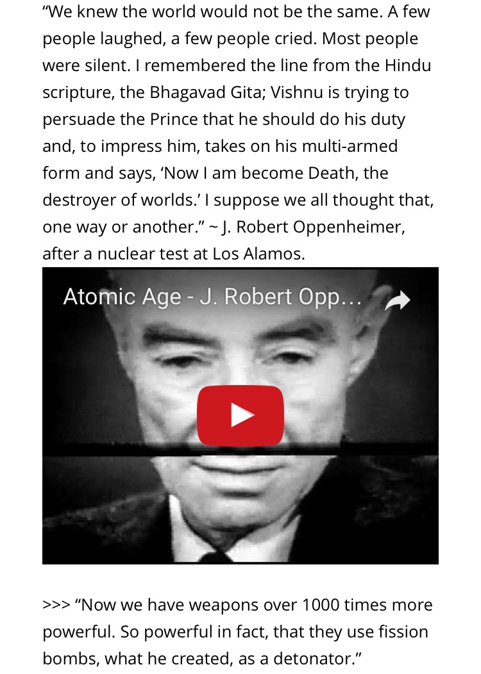
Notes:
1

Slide 2
Do Now: Interpret quote below
Notes:
2

Slide 3
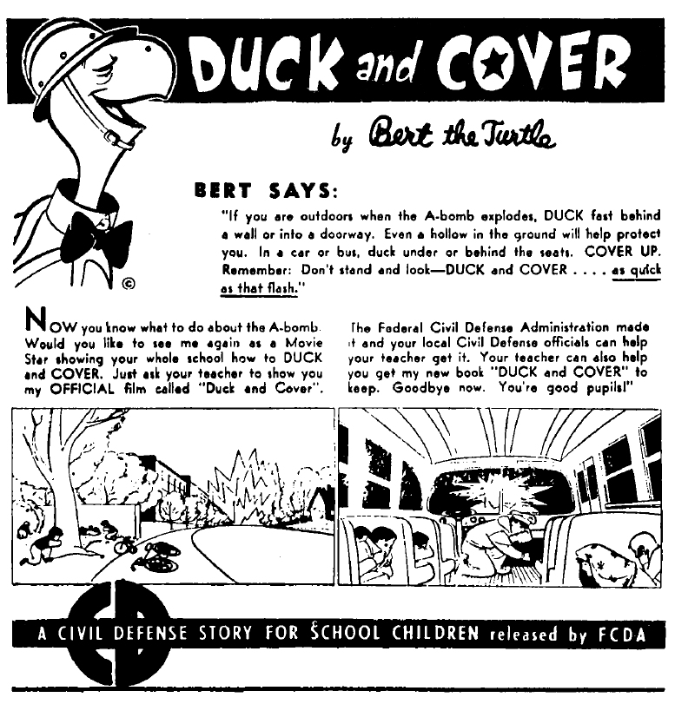

Slide 4
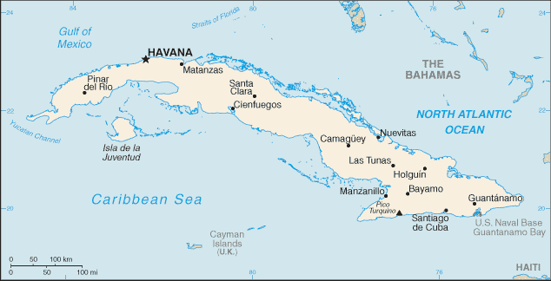
Crisis over Cuba
Notes:
4

Slide 5
Superpowers
In the 1960’s, the United States and the Soviet Union had emerged as superpowers.
The rivalry between the superpowers led to clashes in many places, including Cuba.
*1959: Fidel Castro led a revolution that set up a communist state in Cuba.

Slide 6
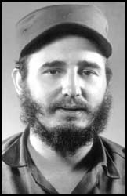
Fidel Castro
Castro’s government took over private companies, including many owned by American businesses.
Thousands of Cubans, especially those from the upper and middle classes, fled to the United States.
In 1961 President D. Eisenhower retired and the problem of dealing with Castro was passed on to the new president, John F. Kennedy.
The new president continued with Eisenhower's policy of trying to assassinate Castro.

Slide 7
Why did we dislike Castro?
Castro's new laws upset the United States. Much of the land taken was owned by United States corporations.
The United States government responded by telling Castro they would no longer be willing to supply the technology and technicians needed to run Cuba's economy. When this failed to change Castro's policies the US reduced their orders for Cuban sugar.
Castro refused to be intimidated by the United States and adopted even more aggressive policies towards them. In the summer of 1960 Castro seized even more United States property worth $850 million.
He negotiated a deal where by the Soviet Union and other communist countries in Eastern Europe agreed to purchase the sugar that the United States had refused to take.
The Soviet Union agreed to supply the weapons, technicians and machinery denied to Cuba by the United States.
Notes:
7

Slide 8
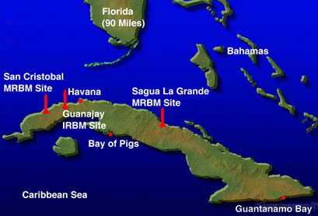
Bay of pigs invasion
The Soviet Union began supplying Cuba with large amounts of aid.
Growing ties between the Soviet Union & Cuba worried American officials.
Why are American officials worried?
Spread of Communism
Soviet Union is a superpower
Cuba is located 90 miles off the coast of Florida.

Slide 9
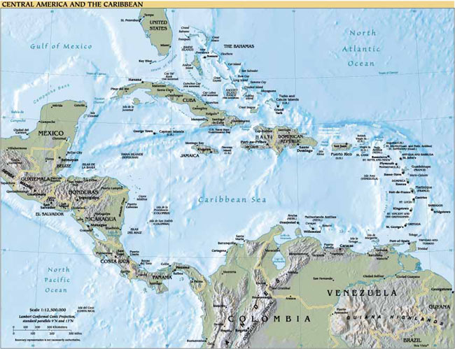
Notes:
9

Slide 10
1961- Kennedy approved plan for Cuban exiles to overthrow Castro.
On April 17, 1961 about 1300 exiles, armed with U.S. weapons, landed at the Bahía de Cochinos (Bay of Pigs) on the southern coast of Cuba. Hoping to find support from the local population, they intended to cross the island to Havana.
It was evident from the first hours of fighting, however, that the exiles were likely to lose. President Kennedy had the option of using the U.S. Air Force against the Cubans but decided against it. Consequently, the invasion was stopped by Castro's army.
By the time the fighting ended on April 19, - 90 exiles had been killed and the rest had been taken as prisoners.
Bay of Pigs invasion strengthened Castro in Cuba and Embarrassed the United States.
Notes:
10
On April 14, 1961, B-26 planes began bombing Cuba's airfields. After the raids Cuba was left with only eight planes and seven pilots. Two days later five merchant ships carrying 1,400 Cuban exiles arrived at the Bay of Pigs. The attack was a total failure.
Two of the ships were sunk, including the ship that was carrying most of the supplies. Two of the planes that were attempting to give air-cover were also shot down. Within seventy-two hours all the invading troops had been killed, wounded or had surrendered.
Castro’s forces quickly rounded up and jailed the invaders

Slide 11
Embarrassed???
The failure of the invasion seriously embarrassed the young Kennedy administration. Some critics blamed Kennedy for not giving it adequate support and others for allowing it to take place at all. The captured exiles were later ransomed by private groups in the U.S.
Additionally, the invasion made Castro wary of the U.S. He was convinced that the Americans would try to take over the island again. From the Bay of Pigs on, Castro had an increased fear of a U.S. incursion on Cuban soil.
Notes:
11

Slide 12
Cuban Missile Crisis
After the Bay of Pigs invasion, Soviet Union gave Cuba more weapons.
October 1962: Pres. Kennedy learned that the Soviets were secretly building missile bases on the island.
If successful, ATOMIC missiles could reach the US within minutes.
Kennedy announced that American Warships will STOP any Soviet ship carrying missiles.
Notes:
12

Slide 13
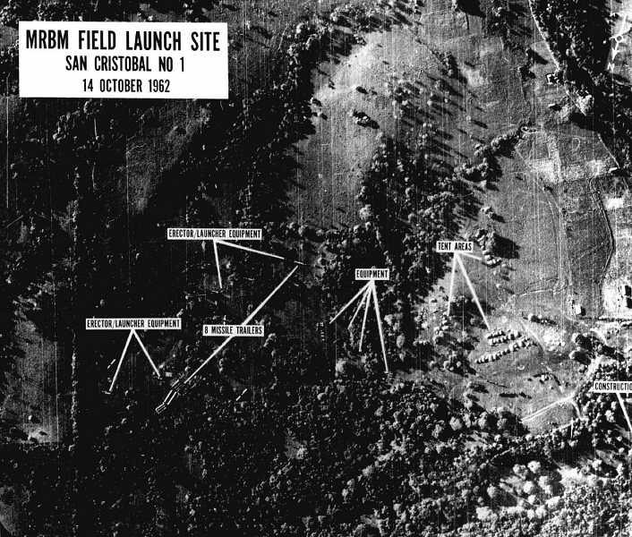
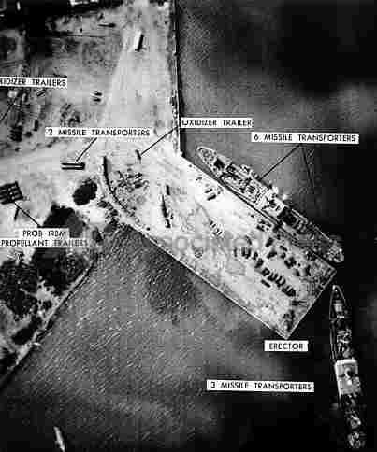
Notes:
13
in the fall of 1962, the administration learned that the Soviet Union was secretly installing offensive nuclear missiles in Cuba. After considering different options, Kennedy decided on a quarantine to prevent Soviet ships from bringing additional supplies to Cuba. He demanded publicly that the Soviets remove the weapons and warned that an attack from that island would bring retaliation against the USSR. After several days of tension, during which the world was closer than ever before to nuclear war, the Soviets agreed to remove the missiles. Critics charged that Kennedy had risked nuclear disaster when quiet diplomacy might have been effective. But most Americans and much of the non-Communist world applauded his decisiveness. The missile crisis made him for the first time the acknowledged leader of the democratic West. In retrospect, the Cuban missile crisis marked a turning point in U.S.-Soviet relations. Both sides saw the need to defuse tensions that could lead to direct military conflict. The following year, the United States, the Soviet Union, and Great Britain signed a landmark Limited Test Ban Treaty prohibiting nuclear weapons tests in the atmosphere.

Slide 14
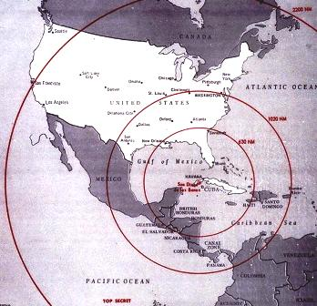

Slide 15
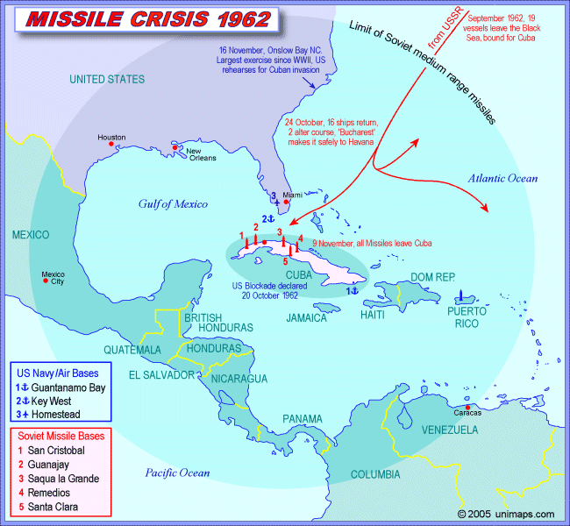
Notes:
15

Slide 16
Cuban Missile Crisis
Soviet Union sent ships, where there was a stand off between them and the US. Soviet ships turned around and returned to the East.
Kennedy's strong stand led the Soviets to a compromise. They agreed to remove missiles from Cuba.
In return, the US promised not to invade the island.
The Cuban Missile Crisis had shaken both American and Soviet officials.
IN ALL THE YEARS OF THE COLD WAR, THIS WAS THE CLOSEST THE WORLD CAME TO A FULL-SCALE NUCLEAR WAR.
Notes:
16

