Slide 1
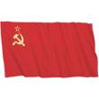
The Cold War
The Sides
The West Vs. The East
(U.S. and its allies) (Soviet Union and its allies)
*After WWII the US and the Soviet Union began a different type of war. They did not clash directly, but instead they competed for power around the world.
*The Cold war will last for nearly 50 years

Slide 2
Causes
From allies to enemies, fought common enemies during the war.
Ultimately the U.S. and the Soviet Union had competing political, economic, and social systems.
Western nations want to spread Democracy and capitalism.
Soviet leaders wanted to spread Communism.
*Chart comparing Democracy and Communism*

Slide 4
Europe After WWII - Terms
The "Iron Curtain" - Winston Churchill (Britain) warned against Soviet expansion into eastern Europe. The "Iron Curtain" cut off Soviet run Eastern Europe from the Democratic governments of the West.

Slide 6
The U.S. tries to prevent Communism from spreading
Containment - President Harry Truman's policy to prevent the spread of Soviet influence beyond where it already existed.
Truman Doctrine - Program to encourage nations to resist communist expansionism.

Slide 7
The Marshall Plan - Secretary of State George Marshall, feared that the millions left homeless and hungry in Europe after WWII, would encourage communist revolutions.
June 1947 the Marshall Plan was approved by Congress providing billions in aid to Western European Countries to help them rebuild their economies.

Slide 8
Crisis in Berlin
France, Great Britain, the U.S. and the Soviet Union controlled the Capital of Germany, Berlin, after WWII. Stalin didn't want to give up his hold on Berlin, so he blockaded his part of the city.

Slide 9
The Berlin Airlift
President Truman ordered American planes to drop supplies into Western Berlin (food, fuel, etc..) This lasted almost a year. Stalin eventually lifted the blockade. Germany would later be divided.

Slide 10
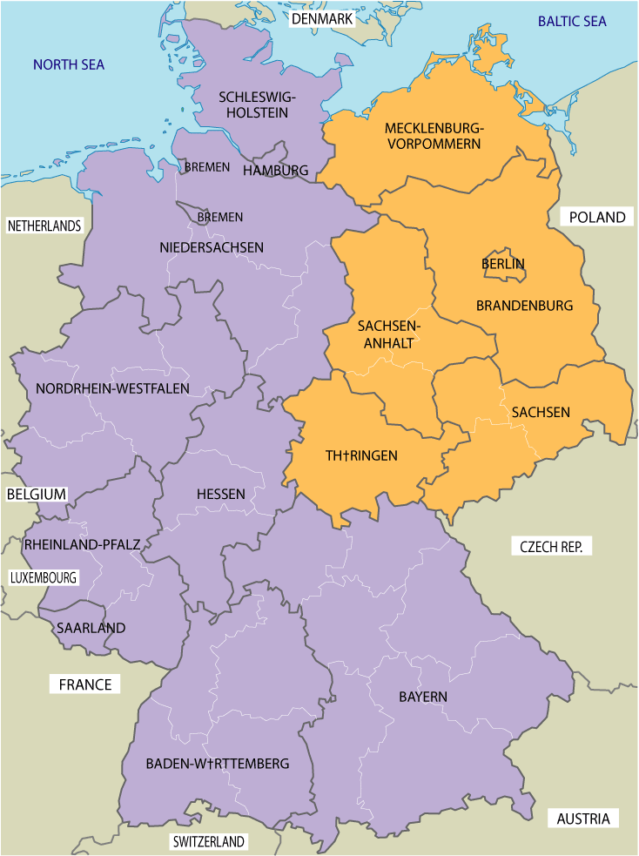
Germany is Divided
The U.S. Britain and France merged their zones into West Germany.
This became a prosperous nation with US aid.
The Soviet zone became East Germany.
It was poorer that West, and had an undemocratic government, many escaped which embarrassed the communists.

Slide 11
The Berlin Wall
The Berlin Wall- 1961, the East German Government built a huge concrete wall topped with barbed wire. It sealed off East Berlin from West Berlin. Anyone who tried to scale the wall and escape would be shot by East German guards.

Slide 12
The Berlin Wall
https://app.discoveryeducation.com/learn/player/d53ad694-6edf-4971-85fb-74f200ef180d

Slide 13
New Alliances and a Peace Keeping Organization
1948, NATO (North Atlantic Treaty Organization) - Key goal was to defend Western Europe against any Soviet threat. 10 nations w/ U.S., and Canada
Warsaw Pact – Soviet Union creates this in response, Czechoslovakia, Hungary, Romania, East Germany, Poland, Bulgaria and Albania.

Slide 14
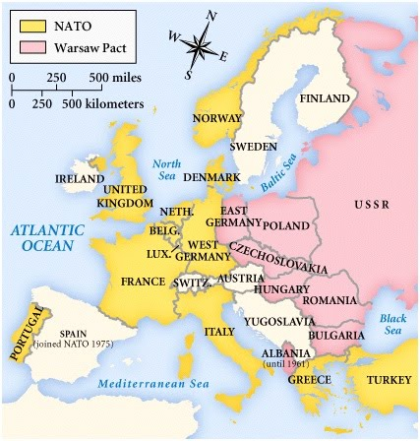

Slide 15
United Nations
June 1945, 50 nations join this peacekeeping organization, based in New York.
Made up of a:
Security Council – responsible for deterring aggression.
General Assembly – every country 1 vote.
Economic and Social Council – promotes economic and social development, world health and education.

Slide 16
Other Events
Sept. 1949 - US learns Soviet Union has tested an Atomic bomb.
Chinese Civil War:
Democrats – Led by Chiang Kai-Shek.
Vs.
Communists – Led by Mao Zedong
1949 - Communists win control of China, set up the People's Republic of China.

